Slide 1

Building a Better Systems Engineering Postgraduate Course research, pedagogy and results
Prof Joseph E Kasser, DSc, CEng², CM, FIET, FIES, FINCOSE, VK5WU, G3ZCZ
https://therightrequirement.com
Presented to the INCOSE-CC
July 2022
Notes:
Second annual lecture ☺

Slide 2
Topics
Purpose of the research
The multidisciplinary research
What to present for learning (not teach)
  Some of the subsystems – conceptual
How to present it (pedagogy)
The prototypes and feedback
The 4% solution
Lessons learned
See if you can be part of that 4%

Slide 3
Purpose of research (traditional)
To create a course to expedite the creation of “outstanding systems engineers” some of whom will become “technical leaders” (engineering leaders)
Need to determine
  What to teach outstanding systems engineers
  Best way to teach it
  How to fast track teaching that comes from “experience”
Construct the course and prototype it

Slide 4
Purpose of research (systems approach)
To create a system to expedite the creation of “outstanding systems engineers” some of whom will become “technical leaders (engineering leaders)”
Need to determine
  What outstanding systems engineers need to know
  Best way for them to learn it
  How to fast track learning that comes from “experience”
Construct the system and prototype it

Slide 5
Topics
Purpose of the research
The multidisciplinary research
What to present for learning (not teach)
  Some of the subsystems – conceptual
How to present it (pedagogy)
The prototypes and feedback
The 4% solution
Lessons learned
See if you can be part of that 4%

Slide 6
Magic happened
Outcomes
  A journey spanning three continents and 20+ years
  A set of requirements for creating outstanding systems engineers
  New and innovative systems thinking and systems engineering tools
  Lots of publications nobody seems to read
    On my website and some on INCOSE’s, and some YouTube videos
  A number of upset and uncomfortable systems engineers in INCOSE
    Challenging assumptions, taking them out of their comfort zone
  A paradigm shift
  A prototype course program
    Began in December 2020, still running
  Now mentoring a few potentially outstanding systems engineers

Slide 7
Topics
Purpose of the research
The multidisciplinary research
What to present for learning (not teach)
  Some of the subsystems – conceptual
How to present it (pedagogy)
The prototypes and feedback
The 4% solution
Lessons learned
See if you can be part of that 4%

Slide 8
Five types of systems engineers*
Type V [Innovator, engineer-leader]
  Problem formulator and problem solver
  Directs and performs systems engineering
Type IV [Problem formulator]
  Has the ability to examine the situation and can define the problem
  [Cannot conceptualise a solution]
Type III [Problem solver]
  Has the expertise to (can) conceptualize the solution system and plan the implementation of the solution
  [Cannot define the problem]
Type II [Practitioner (doer)]
  Has the ability to follow a process to implement a physical solution system
Type I [Apprentice , problem causer]
  Has to be told “how” to so something
Kasser, J. E., Hitchins, D. and Huynh, T. V., Reengineering Systems Engineering, proceedings of the 3rd Annual APCOSE, Singapore, 2009.

Slide 9
Mapping abilities to Types
Ability to find similarities among objects which seem to be different | High | Problem solvers | Innovators
 | Low | Imitators, doers | Problem formulators
Generic perspective
 |  | Low | High
 |  | Ability to find differences among objects which seem to be similar
 |  | Continuum perspective
(Type III)
(Type V)
(Type II)
(Type IV)
“Ability to find” generally comes mainly from application of Generic and Continuum HTPs
* Original table in Gordon G. et al. “A Contingency Model for the Design of Problem Solving Research Program”, Milbank Memorial Fund Quarterly, p 184-220, 1974, cited by Gharajedaghi, System Thinking: Managing chaos and Complexity, Butterworth-Heinemann, 1999

Slide 10
Grouping the Types
Outstanding systems engineers
  Creates the system (solution) the customer needs
  Solves the real problem
    Type V
Good systems engineers
  Creates the system (solution) the customer asks for
  Solves the problem the customer poses
    Type’s III and IV
Systems engineers
  Create the system (solution)
    Types I and II
In any role in the organization hierarchy
  Leader, follower, manager, assistant, etc.

Slide 11
Ratio of systems engineers, good and outstanding systems engineers
Based on observations of systems engineers and students over about 30 years

Slide 12
Ratio of systems engineers, good and outstanding systems engineers
Numbers: estimated base on Pareto principle

Slide 13
Ratio of systems engineers, good and outstanding systems engineers
Numbers: estimated base on Pareto principle

Slide 14
Ratio of systems engineers, good and outstanding systems engineers
Numbers: estimated base on Pareto principle

Slide 15
One path forward (“what”)
Advanced training in pure systems engineering,
Project management,
Lots more experience, mentored
Outstanding systems engineers
Advanced training in applied systems engineering,
project management,
some training in pure systems engineering,
experience,
degrees, etc.
The gap
Good systems engineers
Basic training in applied systems engineering,
e.g. CSEP knowledge, etc.
Systems engineers

Slide 16
Determine what they need to know -1
Product
  Observe scenarios of what systems engineers are doing in the workplace
    Don’t know what is missing
      What they should be but are not doing
    Can institutionalize poor practice
    BPR “as-is” model
  Articulate requirements
Process
  Identify factors that make learning effective
  Scenarios and requirements as above
Combine into the system that will create outstanding systems engineers

Slide 17
Determine what they need to know -2
Product (outstanding systems engineers)
  Conceptualize scenarios of what systems engineers should be doing in the workplace*
    BPR “to-be” model
  Articulate requirements
Process
  Identify factors that make learning effective
  Scenarios and requirements as above
Combine into the system that will create outstanding systems engineers
  * Kasser and Hitchins, “Clarifying the Relationships between Systems Engineering, Project Management, Engineering and Problem Solving”, APCOSEC, Japan, 2013

Slide 18

Limits of a single perspective
I am a system

Slide 19

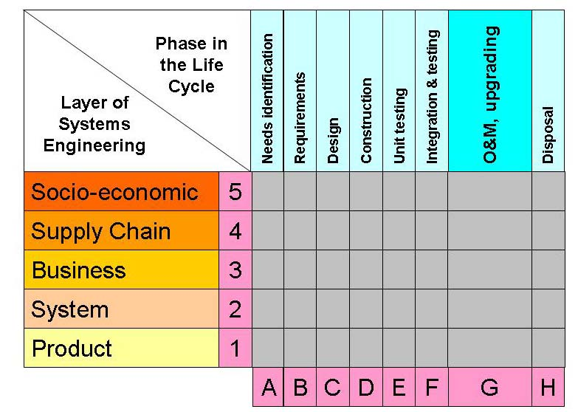
The Hitchins-Kasser-Massie Framework for understanding systems engineering*
Systems engineers work in boxes
Many systems engineers have no idea what is going on in the other boxes
* Kasser and Massie, A Framework for a Systems Engineering Body of Knowledge, proceedings of the 11th International Symposium of the INCOSE, Melbourne, Australia, 2001.
* Kasser, J. E., The Hitchins-Kasser-Massie (HKM) Framework for Systems Engineering, proceedings of the 17th International Symposium of the INCOSE, San Diego, CA., 2007.
  Thanks to Dr Xuan-Linh Tran for redrawing the HKMF in this format
Notes:
19
19
Need has become speak to stakeholders to make sure requirements are correct.
19

Slide 20
Key concept: Roles and activities*
Systems Engineering the Role (SETR)
  What the systems engineer actually does in the workplace
    System architecting, system engineering, project management, testing, designing, etc.
Systems Engineering the Activity (SETA)
  The traditional activities associated with systems engineering
    See next slide for examples
Observations
  Each person’s role is a different mix of activities and may be from more than one (process) domain
  A Type V in one role may be a Type III in another role due to a lack of something
* Kasser, J. E. and Hitchins, D. K., Yes systems engineering, you are a discipline, proceedings of the 22nd Annual International Symposium of the INCOSE, Rome, Italy, 2012.
Notes:
20

Slide 21
SETA in scenarios
Conceptual design
Requirements elicitation, elucidation and management
Architecting
Interface management
Testing
Integrating
Verification and validation
Engineering management
Modeling
Others

Slide 22
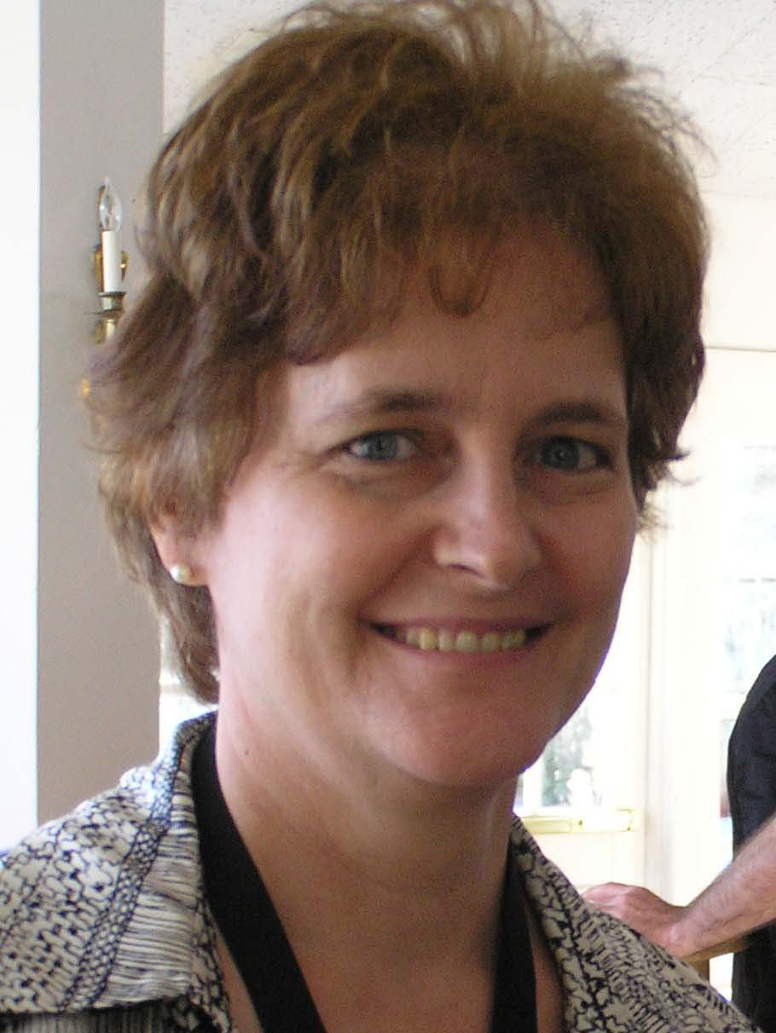
(SETR): Sheard (1996)*
Requirements Owner (RO)
System Designer (SD)
System Analyst (SA).
Validation and Verification (VV)
Logistics and Operations (LO)
Glue (G)
Customer Interface (CI)
Technical Manager (TM)
Information Manager (IM)
Process Engineer (PE)
Coordinator (CO)
“Classified Ads Systems Engineering” (CA)
* Sheard, S. A., 1996, Twelve systems engineering roles, proceedings of the 6th Annual International Symposium of the NCOSE.

Slide 23
(SETR): Jenkins (1969)*
He tries to distinguish the wood from the trees – what’s it all about?
He stimulates discussion about objectives – obtains agreement about objectives.
He communicates the finally agreed objectives to all concerned so that their co-operation can be relied upon.
He always takes an overall view of the project and sees that techniques are used sensibly.
By his overall approach, he ties together the various specializations needed for model building.
He decides carefully when an activity stops.
He asks for more work to be done in areas which are sensitive to cost.
He challenges the assumptions on which the optimization is based.
He sees that the project is planned to a schedule, that priorities are decided, tasks allocated, and above all that the project is finished on time.
He takes great pains to explain carefully what the systems project has achieved, and presents a well-argued and well-documented case for implementation.
He ensures that the users of the operational system are properly briefed and well trained.
He makes a thorough retrospective analysis of systems performance.
* Jenkins, G. M., "The Systems Approach," Systems Behaviour, J. Beishon and G. Peters (Editors), Harper and Row, London, 1969, p. 82.
*

Slide 24
Key concepts: Three types of SETA*
Pure systems engineering
  Systems thinking and beyond
    Cognitive skills, problem formulation/solving, quantitative methods, decision-making, etc.
Applied systems engineering
  Requirements, architectures, V&V, engineering management, engineering, *ilities, etc.
Domain systems engineering
  Problem
  Implementation
  Solution
Your typical systems engineering course
Similar to Mathematics
(pure and applied)
* Kasser, 2013, Perceptions of Systems Engineering, pages 149-150

Slide 25
Pure, applied and domain SETA
Systems engineers
Use cognitive skills
while performing
Activities in a role
Applied systems engineering
Pure systems engineering
In 3 Domains [1]
Domain systems engineering
To enable a solution system to be realized
[1] Problem, solution and implementation

Slide 26
Initial approach
What’s the first thing outstanding systems engineers usually do when they understand the nature of the problem?
Plagiarize!!!!
Determine what other people in the past have done when faced with the same or similar problem
  Concept behind TRIZ
Examine and adjust for similarities and differences in the situations
Coming from academia, my approach was to reuse course components to create the system, not create a course
There is going to be an educational subsystem

Slide 27
Processes for crafting a degree
Benchmarking
  Benchmark other universities
  Aggregate topics
  Position on top of normal distribution curve
    Teach most common topics
Faculty capability
  Benchmark other universities
  Bundle common modules with modules faculty can teach

Slide 28
Process for Crafting a Degree*
Customer needs
Body of Knowledge
Benchmarks (other universities)
Delivery mechanism
Subject matter (knowledge and skills)
Factors that make learning effective
Pedagogy
Assess teaching and learning results
Deliver the classes
* Kasser J.E, Sitnikova E, Tran X.L, Yates G”, Optimising the Content and Delivery of Postgraduate Education in Engineering Management for Government and Industry”, proceedings of the International Engineering Management Conference (IEMC), St. John's, Newfoundland, Canada, September 11-14, 2005.

Slide 29
Benchmarking study based on website info*
Professional Master's in Applied Systems Engineering
  Georgia Tech
MSc in Engineering and Management
  MIT System Design and Management Program
MSc in Systems Engineering
  Missouri University of Science and Technology
MEng in Systems Engineering
  Penn State University
MSc (Major in Systems Engineering)
  Southern Methodist University
MEng in Systems Engineering
  Stevens Institute of Technology
MSc in Systems Engineering
  University of Maryland – Institute for Systems Research
MSc in Industrial and Systems Engineering
  University of Michigan
MSc in Industrial and Systems Engineering
  University of Southern California – Viterbi School of Engineering
MSc in Systems Engineering
  Worcester Polytechnic Institute
Master of Defence Technology Systems (MDTS)
    TDSI in National University of Singapore (NUS) for Systems Engineering 1.0
* 1-10 exhibited at INCOSE IS 2013
*Kasser J.E., Arnold E., Academia is not teaching the right things in systems engineering Master’s courses, in Are Postgraduate Courses in Systems Engineering Teaching the Right Things?, in the 24th International Symposium of the INCOSE, Las Vegas, NV, 2014.
*Kasser, J. E. and Arnold, E., Benchmarking the Content of Master’s Degrees in Systems Engineering in 2013, proceedings of the 26th International Symposium of the INCOSE, Edinburgh, Scotland, 2016.

Slide 30
HKMF area coverage in 2013
Hitchins Layer | 1 | 2 | 3 | 4 | 5 | 6 | 7 | 8 | 9 | 10 | 11
5 Socio-economic |  | 0.06
4 Supply chain |  | 0.19
3 Business/SoS | 0.10 | 0.06 | 0.10 |  |  |  | 0.10 |  |  |  | 0.10
2 System | 0.80 | 0.19 | 0.50 | 0.17 | 0.30 | 0.50 | 0.50 | 0.20 | 0.10 | 0.40 | 0.50
1 Product |  | 0.13 |  |  |  |  |  |  | 0.10 |  | 0.20
Gaps in required courses
Lifecycle phase | 1 | 2 | 3 | 4 | 5 | 6 | 7 | 8 | 9 | 10 | 11
Needs | 0.10 | 0.31 | 0.10 |  |  |  |  |  |  |  | 0.20
B. Requirements | 0.01 | 0.01 | 0.23 | 0.17 | 0.10 | 0.10 | 0.10 |  |  | 0.01 | *
C. Design/Architecting | 0.10 | 0.06 | 0.23 | 0.17 | 0.10 | 0.10 | 0.05 |  |  | 0.11 | *
D. Construction |  | 0.01 |  |  |  |  |  |  |  |  | *
E. Unit testing |  | 0.01 |  |  |  |  |  |  |  |  | *
F. Integration & Testing | 0.10 | 0.01 | 0.03 |  | 0.10 | 0.10 | 0.10 |  |  | 0.12 | *
G. Operations | 0.01 |  |  |  |  |  |  |  |  |  | *
H. Disposal | 0.01 |  |  |  |  |  |  |  |  |  | *
0.1 means 1 course
* Present but not documented on web site, expect same applies to other degrees

Slide 31
Percentage courses by types of degrees in 2013
No degree is purely one type
0.1 means 1 course
Degree | 1 | 2 | 3 | 4 | 5 | 6 | 7 | 8 | 9 | 10 | 11
Pure systems engineering | 0.25 | 0.09 | 0 | 0.50 | 0.10 | 0 | 0 | 0.10 | 0 | 0 | 0.10
Applied systems engineering | 0.55 | 0.22 | 0.50 | 0.42 | 0.80 | 0.40 | 0.40 | 0 | 0 | 0.60 | 0.40
Domain systems | 0 | 0 | 0 | 0 | 0 | 0 | 0 | 0.10 | 0 | 0 | 0.30
Management | 0.10 | 0.31 | 0.10 | 0.08 | 0 | 0.10 | 0.20 | 0.10 | 0.20 | 0.20 | 0
Total* | 0.90 | 0.62 | 0.60 | 1.00 | 0.90 | 0.50 | 0.60 | 0.30 | 0.20 | 0.80 | 0.80
Numbers show percentage of topics in required courses in degrees
Example:
If degree has 10 courses, 5 required courses = 0.50
1 required course = 10%, 1 elective course = 0%
* Numbers may not add up to 100% due to electives
31

Slide 32
What is systems thinking?
It depends on who you ask or read
Difficult to learn
Difficult to teach
Two schools of thought
  Systemic – the system
  Systematic – the process
Holistic approach – use both
  Systemic
    Be all the blind men
  Systematic
    Use the problem-solving process

Slide 33
Aggregating views
Systemic thinking
  Thinking about a system as a whole to gain an understanding of the system
  Not as a whole to be taken apart (Ackoff, 1991)
  Use of different perspectives (Barry Richmond, 1993)
Systematic thinking
  Employing a methodical step-by-step manner (process) to think about something or to achieve a goal
Beyond systems thinking
  Both are needed (Gharajedaghi, 1999)
  More that that, Ackoff wasn’t entirely correct
  The perspectives you need to understand the situation depend on the problem
  Need even more perspectives for solving the problem
Richmond, B., Systems thinking: critical thinking skills for the 1990s and beyond, System Dynamics Review, Vol 9 (1993), no. 2, 113-133.

Slide 34
The Holistic Thinking Perspectives*
I’m systems engineering
1. Big Picture
9. Scientific
2. Operational
Issue or situation
3. Functional
4. Structural
5. Generic
6. Continuum
7. Temporal
8. Quantitative
External
Big picture
Operational
Internal
Functional
Structural
Progressive
Generic
Continuum
Temporal
Remaining
Quantitative
Scientific
*STT 10.1

Slide 35
Critical thinking
Five steps or levels*
  4 Strategic re-visioner
  3 Pragmatic performer
  2 Perpetual analyzer
  1 Biased jumper
  0 Confused fact finder
* Wolcott, S. K. and Gray, C. J., Assessing and Developing Critical Thinking Skills, 2003, http://www.wolcottlynch.com/Downloadable_Files/IUPUI%20Handout_031029.pdf, accessed on 21 May 2013, page not found 9 June 2022

Slide 36
Needs, wants and problems
Differences between
  What customers want
  What customers need
Customers |  | Know what they need
 |  | Yes | No
Know what they want | Yes | Well-structured problem | Ill-structured problem
 | No | Ill-structured problem | “Well-structured problem”
Notes:
Work out what customer needs and convince them that is what they want

Slide 37
Proposed Maturity Model for measuring competencies of systems engineers*
 |  | Type I | Type II | Type III | Type IV |  | Type V
Knowledge
Systems engineering (applied) | Declarative |  | Procedural | Conditional | Conditional | Conditional
Three Domains (problem, implementation and solution) | Declarative |  | Declarative | Conditional | Conditional | Conditional
(pure) Cognitive characteristics
System Thinking
Descriptive | Declarative |  | Procedural | Conditional | Conditional | Conditional | Conditional
Prescriptive | No |  | No | Conditional | Conditional | Conditional | Conditional
Critical Thinking | Confused fact finder |  | Perpetual analyser | Pragmatic performer | Pragmatic performer | Strategic re-visioner | Strategic re-visioner
Individual traits (sample)
Communications | Yes |  | Yes | Yes | Yes | Yes | Yes
Management | No |  | Yes | Yes | Yes | Yes | Yes
Leadership | No |  | No | Yes | Yes | Yes | Yes
Modified from Kasser, J. E. and Frank, M., A Maturity Model for the Competency of Systems Engineers, proceedings of the 20th International Symposium of the INCOSE, Chicago, IL., 2010.
Notes:
37
37

Slide 38
Competency Model Maturity Framework*
 | 1 | 2 | 3 | 4 | 5 | 6 | 7 | 8 | 9 | 10 | 11
Knowledge
Systems engineering (pure) | 0.20 | 0.09 |  | 0.50 | 0.10 |  |  | 0.10 |  |  | 0.10
Systems engineering (applied) | 0.60 | 0.22 | 0.50 | 0.42 | 0.80 | 0.40 | 0.40 |  |  | 0.60 | 0.40
Problem domain |  |  |  |  |  |  |  |  |  |  | 0.30
Implementation domain |  |  |  | 0.08
Solution domain |  |  |  |  |  |  |  |  |  |  | 0.30
Cognitive characteristics
System/holistic thinking |  |  | 0.02 |  |  |  |  |  |  |  | 0.10
Critical thinking |  |  |  | 0.02 |  |  |  |  |  |  | 0.02
Problem formulation | 0.02 |  |  | 0.02 |  |  |  |  |  |  | 0.01
Problem solving | 0.10 |  |  | 0.08 |  |  |  |  |  |  | 0.05
Individual traits
Leadership | 0.10
Management | 0.10 | 0.31 | 0.20 | 0.08 |  | 0.10 | 0.20 | 0.10 |  | 0.20
Communications |  | 0.03 |  |  |  |  |  |  | 0.20 |  | *
Ethics |  |  |  |  |  |  |  |  |  |  | *
0.1 means 1 required course
* Kasser et al., Systems Engineering, 2014

Slide 39

IV&V in December 2020
Provides a description of how and why systems engineers can be, and have been, successful
Offers successful attributes
Focuses on the key positive qualities
Drills down to the success features to aim for
The failure characteristics to avoid
Sets a model for achievement and behavior for future systems engineers to follow a successful path

Slide 40
Topics
Purpose of the research
The multidisciplinary research
What to present for learning (not teach)
  Some of the subsystems – conceptual
How to present it (pedagogy)
The prototypes and feedback
The 4% solution
Lessons learned
See if you can be part of that 4%

Slide 41
Undesirable situation (academic): Operational perspective
Traditional lecture by the instructor
  summarises the knowledge for the session and in the readings
  highlights the main points
  adds additional material pertinent to the session
Flipped classroom
  Students are supposed read the session material individually before the session begins (ideal)
Group exercises
  Presentations
Short discussion facilitated by the instructor

Slide 42
Undesirable situation (academic):
Functional perspective
Students have different learning styles
  Seeing, hearing etc.
Teachers have different teaching styles
  Lecturing, discussing, focus on type of knowledge, etc.
Mismatches
  Boredom
  Poor performance
  Drop outs
Effectiveness of delivery method

Slide 43
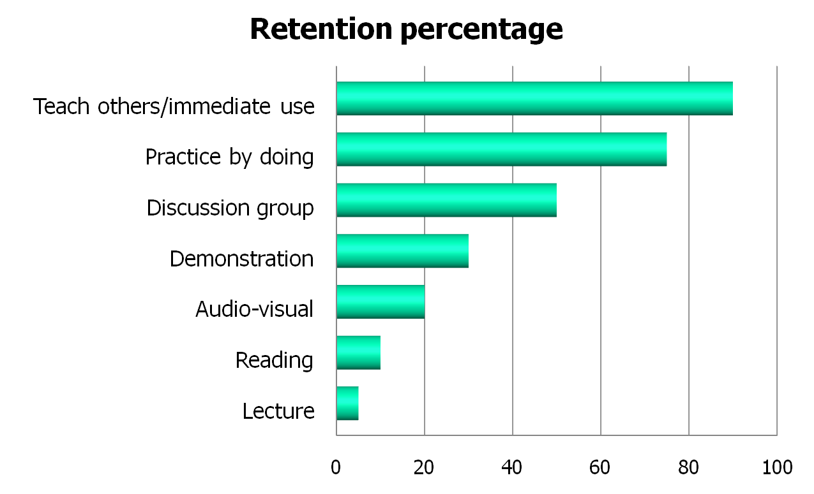
Quantitative perspective:
Retention rate after 2 weeks
Knowledge Readings
Exercises
This is what I call a flipped classroom
Redrawn Dales’ cone and Learning Pyramid
Notes:
What is the best/worst way of learning?
43

Slide 44
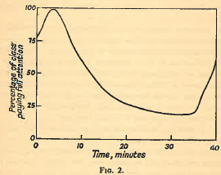
Attention span*
* Mills, H. R., Techniques of technical training, Cleaver-Hume Press, London, 1953.
Every teacher, and preacher should know this
Notes:
44

Slide 45
Desirable situation (academic)
Providing the five top aspects of the engineering design process that best equip secondary students to understand, manage, and solve technological problems (Wicklein, et al., 2009): (Pure SETA)
  Multiple solutions to a problem/requirement
  Oral communications
  Graphical/pictorial communication
  Ability to handle open-ended/ill-defined problems
  Systems thinking
Grading based on cognitive skills and knowledge (Pure SETA)
  Incorporating higher levels of Bloom’s taxonomy
Going beyond systems thinking to holistic thinking
  Systems thinking provides understanding
  Holistic thinking identifies problems and provides solutions

Slide 46
Five top aspects (requirements) in 2013
The five top aspects of the engineering design process that best equip secondary students to understand, manage, and solve technological problems (Wicklein, et al., 2009):
  Multiple solutions to a problem/requirement
  Oral communications
  Graphical/pictorial communication
  Ability to handle open-ended/ill-defined problems
  Systems thinking
 | 1 | 2 | 3 | 4 | 5 | 6 | 7 | 8 | 9 | 10 | 11
1. Multiple solutions to a problem/requirement |  |  |  |  |  |  |  |  |  |  | HT
2. Oral communications |  |  |  |  |  |  |  |  |  |  | HT
3. Graphical/pictorial communication |  |  |  |  |  |  |  |  |  |  | HT
4. Ability to handle open-ended/ill-defined problems |  |  |  |  |  |  |  |  |  |  | HT
5. Systems thinking |  |  | 0.01 |  |  |  |  |  |  |  | HT
0.1 means 1 course

Slide 47
Topics
Purpose of the research
The multidisciplinary research
What to present for learning (not teach)
  Some of the subsystems – conceptual
How to present it (pedagogy)
The prototypes and feedback
The 4% solution
Lessons learned
See if you can be part of that 4%

Slide 48
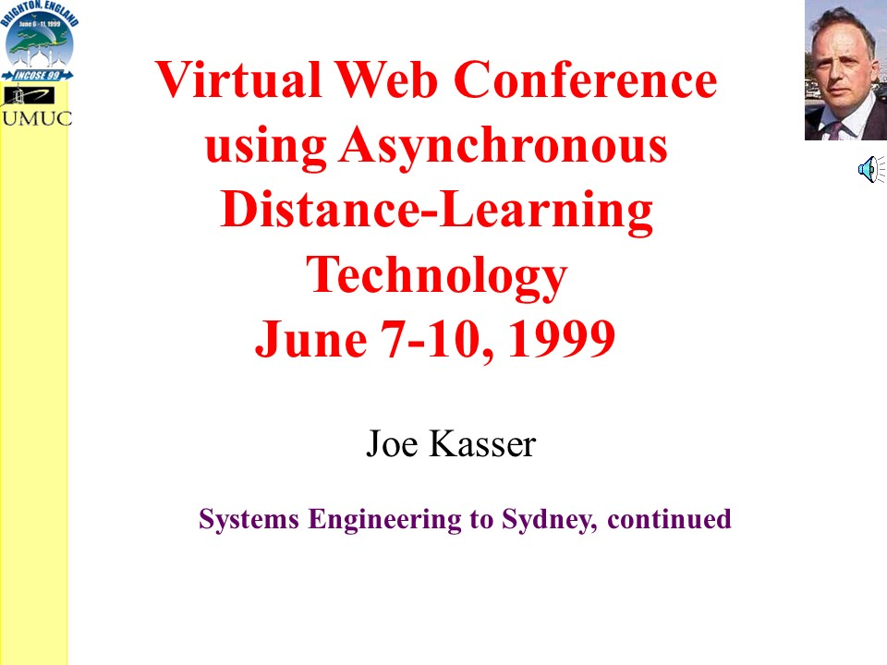
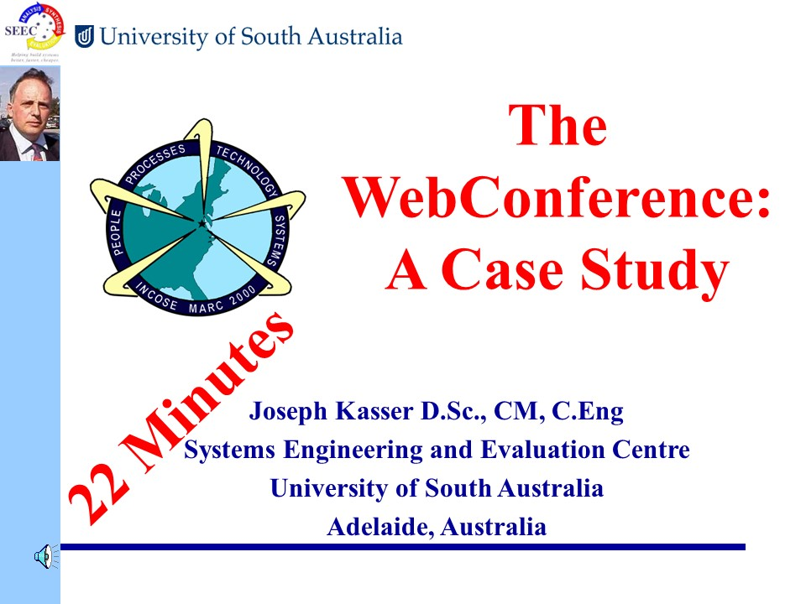
Early prototyping results
Based on similarities between classes and symposium sessions
First recorded lectures at UMUC

Slide 49
Grading vs. delivery mode
Table 2 Final Grades for MSWE 617
Table 1 Final Grades for MSWE 648
Class | Delivery Mode | Students | Mean | Std Dev
1998-02 | Face to face Semester | 20 | 86.84 | 6.26
1999-09 | WebTycho Semester | 17 | 76.70 | 7.65
2000-02 | WebTycho Semester | 17 | 84.71 | 5.83
2006-0 | WebTycho Semester | 25 | 85.93 | 5.08
2006-1 | WebTycho Semester | 24 | 83.30 | 8.38
Table 2 Final Grades for MSWE 617 Capstone class
Class | Delivery | Students | Mean | Std Dev
1999-02 | Face-to-face Semester | 20 | 89.59 | 2.83
2000-02 | Web-assisted Semester | 30 | 88.38 | 3.44
WebTycho was UMUC’s online distance learning platform

Slide 50
Baseline: The balanced classroom
Classroom sessions
Lecture
(online
Face2face)
Exercises
Knowledge readings
Flipped classroom
Individual assignments
Assessment
Teamwork
Each session (BWMQC)
Designed for
Authentic assessment
Workplace emulation
Blended learning

Slide 51
Solution situation-1
Classroom session
Lecture
Exercises
Knowledge readings
Individual assignment
Knowledge readings provide additional and extra opportunities
5 top aspects (Wicklein, et al.) (student’s perspective) | Lecture | Exercises | Knowledge readings
Multiple solutions to a problem/requirement | Listened | Experienced | Experienced examples
Oral communications | - | Experienced | Experienced
Graphical/pictorial communications | Received | Experienced | Experienced
Ability to handle open-ended/ill-defined problems | - | Experienced | -
Systems thinking | Listened | Went beyond | Went well beyond

Slide 52
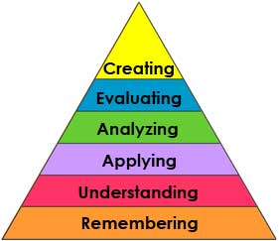
Solution situation-2
Classroom session
Lecture
Exercises
Knowledge readings
Individual assignment
Bloom’s taxonomy |  | Lecture | Exercises | Knowledge readings
6 | Creating | - | ? | √
5 | Evaluating | - | ? | √
4 | Analyzing | - | ? | √
3 | Applying | - | √ | -
2 | Understanding | Unknown | √ | √
1 | Remembering | Listened | √ | √

Slide 53
Grading
Grade | Taxonomy level |  | Ability being tested
A+ | 6 | Creating | Can the student create a new product or point of view?
A | 5 | Evaluating | Can the student justify a stand or decision?
B+/B | 4 | Analysing | Can the student distinguish between the different parts?
B- | 3 | Applying | Can the student use the information in a new way?
C+ | 2 | Understanding | Can the student explain ideas or concepts?
C | 1 | Remembering | Can the student recall or remember the information?
Downside – grading on a curve is difficult
Students can pass course with basic cognitive skills
53

Slide 54
Compliance matrix
Requirements | Lecture | Exercises | Knowledge readings | Individual assignment
Knowledge of 3 systems engineering domains | Poor | In between | Best | Repeated
Multiple solutions to a problem/requirement | Listened | Experienced | Experienced additional examples | Not seen
Oral communications | - | Experienced | Experienced | -
Graphical/pictorial communications | Received | Experienced | Experienced | -
Ability to handle open-ended/ill-defined problems | - | Experienced | Depends on external readings | Depends on assignment
Systems thinking | Listened | Went beyond | Went well beyond | Depends
Cognitive skills | - | Used | 5 out of 6 in Bloom’s taxonomy | Depends
Teamwork | Some | Experienced | Experienced | Definitely not

Slide 55
Exercise 5-1
Conceptualize at least 2 risks for the physical subsystems identified in Exercise 4-2
Conceptualize at least 1 way of mitigating each identified risk
Prepare a <5 minute presentation containing
  The problem posed by the exercise formulated according to the problem formulation template
  Show this slide
  A representative sample of the risks and mitigation approaches
  A compliance matrix for the exercise
  Lessons learned from exercise
Save as a PowerPoint file in format Exercise5-1-abcd.pptx
    abcd = 4 characters that will identify your postings in this course
Post in LinkedIn group
Notes:
Class is a system
Use cases show system in action
undefined term The scenarios or use cases

Slide 56
Knowledge reading exercise 5-3
Prepare knowledge presentation of reading 0503 (<5 min)
  Formulate problem per problem formulation template
  Summarize content of reading (<1 minute).
  Show the compliance matrix
  Show this slide and version number of lesson
  List the main points (<1 minute).
  Prepare a brief on two main points.
  Brief on one main point (<1 minute per point).
  Reflect and comment on reading (<2 minute).
  Compare content with other readings and external knowledge.
  State why you think the reading was assigned to the module.
  Summarize lessons learned from module and indicate source of learning; e.g. readings, exercise, experience, etc. (<2 minutes).
Save as a PowerPoint file as Exercise5-3-abcd.pptx
Post in the LinkedIn group

Slide 57
Brunei and Singapore student comments
“I've learnt to look at problems using STP and generate ideas based on different perspectives”. ~ Engineer, ASTAR
“Learnt systems thinking, critical thinking, holistic thinking, different perspectives, introduced broad coverage of SE”. ~ Engineer, DSO
“The course teaches me on how to think holistically and manage ideals and using the tools to organize raw ideas and apply to dealing with problem”. ~ Engineering Officer, CSTRAD, MINDEF Brunei
“Applying techniques learnt through exercises. Brainstorming techniques. Applying system thinking to real problems.” ~ Anonyms, NEA
“Systematic concepts for identifying problems, brainstorming for solutions etc. N² Chart, OARP, FRAT, SPARK are useful tools in Systems Engineering. More importantly, I have learnt new perspectives to look at a system - a Systems Thinking Perspectives (STP)” ~ AD, PUB
57

Slide 58
Results: Grades
Initial grades match observed student behaviour
Can be adjusted to curve by moving changing thresholds
Split cognitive skills Low cognitive skills

Slide 59
Topics
Purpose of the research
The multidisciplinary research
What to present for learning (not teach)
  Some of the subsystems – conceptual
How to present it (pedagogy)
The prototypes and feedback
The 4% solution
Lessons learned
See if you can be part of that 4%

Slide 60
Delivery: the 4% solution
No time limit (>52 weeks)
New participants can join at any time
Synchronous live weekly Zoom scheduled group sessions (recorded for use as a resource)
  Exercises emulate real-world
  Exercise and knowledge readings presentations
    Immediate correction on misinterpretations
  Participant real-world problem discussions – out of the box experiences in other application domains
  Learning by absorption fast tracks learning and experience
  One-on-one sessions also available
Asynchronous short lectures
Asynchronous discussions in private LinkedIn group
  Thinking time before responding
  Notices of interest
  References to additional material of interest, resource
Self-paced for individuals
  Beware procrastination and use just-in-time
Good opportunity to extend personal network
Instructor becomes your coach and mentor ($50,000 value minimum)

Slide 61
Course architecture
The lectures are self-paced so you can stop them and replay parts until you understand the content. This design is responsive to a few past participant comments that the lecture was too fast.
The exercises allow you to practice applying what you have learnt. You post your responses to the exercises in the Asynchronous Group. A good source of material to use as comparisons in the knowledge reading exercises can be found at Researchgate.net and Google scholar.
The interaction takes in two ways.
  A live Zoom meeting once a week at the regularly scheduled time. It is focused on participant questions and a presentation/discussion of the exercises.
  Questions and comments which are posted and answered in the asynchronous group within a specified time limit.

Slide 62
Prototyping - results
Prototype offered free in December 2020 and January 2021 to my past online students (who showed potential Type V characteristics), INCOSE and public via LinkedIn
10 initial expressions of interest
4 initial shows in the Zoom weekly sessions
No known INCOSE shows
4 joined during 2021 and 2022
3 dropped out
1 sort of active in alternate live session
1 graduated (did all the exercises) and drops in occasionally

Slide 63
Topics
Purpose of the research
The multidisciplinary research
What to present for learning (not teach)
  Some of the subsystems – conceptual
How to present it (pedagogy)
The prototypes and feedback
The 4% solution
Lessons learned
See if you can be part of that 4%

Slide 64
Lessons learned
It’s post-postgraduate
It’s not for everybody
Free doesn’t work
No need to complete an exercise before presenting it
  It’s actually preferable not to
Students show progress quickly
Students need time to adjust
Too much content?
It can be a lot of fun as well as educational
Further research needed to find optimal class size

Slide 65
It’s post-postgraduate
Does not fit into semester or traditional cohort type of class
  Hybrid of “master-apprentice” and classroom educational models
  More than book learning
  Most of the value is in the program architecture
  Most traditional academics without real-world experience could not lead this class format
Participants can join at any time
  Learning by immersion and iteration
Lots of shared real-world experience
  In different domains
No firm ending date, it’s a resource

Slide 66
It’s not for everybody
Instructors
  Every session is different
    Participant presentation, real-world problem, experiential stories, etc.
  Need to be knowledgeable, experienced and able to guide the participants in reaching solutions (creating knowledge) rather than telling
    Master-apprentice
Students/participants
  High applicant rejection and initial drop out rate
  Participants need the right aptitude and experience
  Participants need to be internally motivated to learn and succeed
    Not for minimum level of effort (MLE) students

Slide 67
Mind the gap
Performance^{[1]} = ƒ (Ability * Motivation)
where,
Ability = ƒ (Aptitude * (Training + Experience))
Motivation is a function of attitude, experience, recognition and expectations.
Ability refers to how well a person can perform at the present time. If a person lacks the ability to accomplish a task, no amount of motivation or effort will lead to better performance^{[2]}.
Aptitude refers to whether an individual can be brought through training and experience to a specified level of ability.
[1] Lawler, Edward E. III, Motivation in Work Organizations, Brooks/Cole Publishing Company, 1973, pp 8 - 9.
[2] Kast Fremont E., Rosenzweig James E., Organization and Management A Systems and Contingency Approach, McGraw--Hill Book Company, Third Edition, 1979, p 246.

Slide 68
Free doesn’t work
Motivation varies according the circumstances
Interested lurkers in early days
Finance is a motivator (a tangible incentive)
  Enough $$$ to make it serious

Slide 69
No need to complete an exercise before presenting it
Exercises are designed to emulate real world of iteration
Some outstanding systems engineers prioritize and work iteratively until schedule is exhausted
Live classroom exercises are only the first iteration
Students begin by spending lots of time to complete the exercise
Students need to learn to present ‘work in progress’ even when the way forward is clear

Slide 70
Students show progress quickly
Feedback is provided on content, correctness of content, presentation graphics and layout
Exercises emphasize iteration and repetition
Sometimes alternate ways of presenting the information are discussed
  E.g. bar charts vs. Kiviat (radar) plots
Students can compare their presentations made in later sessions with those in earlier sessions

Slide 71
Students need time to adjust
Students are mired in academic paradigm with respect to exercises; this is a different paradigm containing some real-world emulation
  Iterative approach to exercises
  Exercises are optional although not doing them reduces learning effectiveness
  Work, family and other commitments don’t affect learning (as long as participant attends, even without presenting)
Mistakes are learning opportunities and provide discussion points
The best presentations are those that provide lots of learning opportunities
Readings are not meant to be read from start to finish, they should be scanned iteratively, gaining more understanding in each iteration

Slide 72
Too much content?
Traditional ten modules at beginning
  A module may have several parts
  Each part of a module may have more than one exercise
  Modules contain an introductory lecture and in-depth readings.
  Website is designed for impact
Pure systems engineering changed from two modules to a separate prerequisite program
  Two modules were not enough
  Creating Outstanding Problem Solvers
Flexible content
  Need in depth additional optional module on a SETA activity, one can be developed to order and becomes a resource
    E.g. a module on requirements in depth
    E.g. a module on bringing systems engineering into an organization

Slide 73
Topics
Purpose of the research
The multidisciplinary research
What to present for learning (not teach)
  Some of the subsystems – conceptual
How to present it (pedagogy)
The prototypes and feedback
The 4% solution
Lessons learned
See if you can be part of that 4%

Slide 74
Ratio of systems engineers, good and outstanding systems engineers
Numbers: estimated base on Pareto principle

Slide 75
One path forward (“what”)
Advanced training in pure systems engineering,
Project management,
Lots more experience, mentored
Outstanding systems engineers
Advanced training in applied systems engineering,
project management,
some training in pure systems engineering,
experience,
degrees, etc.
The gap
Good systems engineers
Basic training in applied systems engineering,
e.g. CSEP knowledge, etc.
Systems engineers

Slide 76
Can you cross the gap?
Outstanding systems engineers
The gap
Good systems engineers
Systems engineers

Slide 77
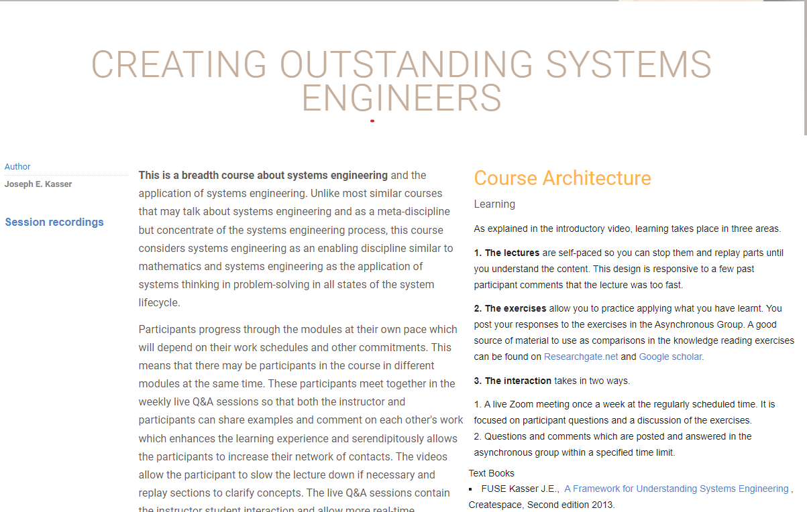
Do you have what it takes?
Are you stuck in the Type II process paradigm?
Are you interested in crossing that gap
Find out if you can
Join me and a small select group for at least 30 days FREE
Full access to two programs
https://therightrequirement.com/
Ask not if you can afford to do it
Ask rather if you can afford not to do it

Slide 78
Summary
Purpose of the research
The multidisciplinary research
What to present for learning (not teach)
  Some of the subsystems – conceptual
How to present it (pedagogy)
The prototypes and feedback
The 4% solution
Lessons learned
See if you can be part of that 4%

Slide 79
Questions and comments?
Interested but don’t want to try the program at this time
Talk to me and others in the online Oasis Café using Zoom
  Meeting ID: 873 4055 1993
  Passcode: 557756
  Daily; Monday to Thursday at 7 pm New York local time
I’m also online for students and others
  Mondays at 8 am Zurich local time
My thanks to Bruce Lerner, Raid AlQaisi and Shirley Tseng who made useful comments in the online Oasis café during the preparation of this presentation

