Slide 1
INCOSE Chesapeake Chapter Webinar
Understanding INCOSE SEP Certification
June 24, 2023
Host: Dr. Steve Biemer, CSEP

Slide 2
First…
Smile for the camera ☺

Slide 3
Agenda
What is INCOSE Certification?
Why get certified?
How to get certified?
How to stay certified?
INCOSE Systems Engineering Handbook, 4th Edition Summary
INCOSE Digital Systems Engineering Process Model

Slide 4

What is INCOSE Certification?
This Photo by Unknown Author is licensed under CC BY-NC

Slide 5
What is INCOSE Certification?
“Systems Engineering Professional (SEP) certification formally recognizes your progress through your career as you develop and apply
systems engineering knowledge and practices.”
https://www.incose.org/systems-engineering-certification

Slide 6
What is INCOSE Certification?
“Systems Engineering Professional (SEP) certification formally recognizes your progress through your career as you develop and apply
systems engineering knowledge and practices.”
Certification is based on your systems engineering knowledge as described in ISO 15288
and
your level of experience
https://www.incose.org/systems-engineering-certification

Slide 7
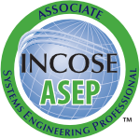
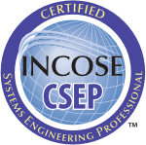
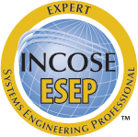
What is INCOSE Certification?
“Systems Engineering Professional (SEP) certification formally recognizes your progress through your career as you develop and apply
systems engineering knowledge and practices.”
https://www.incose.org/systems-engineering-certification

Slide 8
What is INCOSE Certification?
The Associate Systems Engineering Professional (ASEP) is recognized as knowledgeable but without demonstrated SE experience. The qualification for the ASEP is possession of SE knowledge typical of a junior systems engineer, as evidenced by passing the knowledge exam.
https://www.incose.org/systems-engineering-certification

Slide 9
What is INCOSE Certification?
The Certified Systems Engineering Professional (CSEP) is recognized as a systems engineering practitioner who has demonstrated knowledge and experience in many aspects of the discipline. The qualifications for this level include education, SE knowledge, and SE experience that serve various job profiles of an experienced, all-round systems engineer.
https://www.incose.org/systems-engineering-certification

Slide 10
What is INCOSE Certification?
The Expert Systems Engineering Professional (ESEP) is a recognized and distinguished systems engineering leader. The ESEP has a broader and deeper experience in performing and leading systems engineering than the CSEP. The ESEP has at least twenty years of systems engineering experience and is the person others seek with specific, challenging, technical questions. He or she is not an expert in all aspects of systems engineering but is the expert for some aspects of SE and could perform adequately in many.
https://www.incose.org/systems-engineering-certification

Slide 11
INCOSE Certification Level Requirements
Leadership
Experience
Experience Confirmation
Knowledge
Written Exam
Academic Equivalency
None
None
None
Written Exam
Academic Equivalency
None
5 years minimum
3 references
3 references
interview
Recognized
20/25 years minimum
None
https://www.incose.org/systems-engineering-certification/becoming-certified

Slide 12
INCOSE Certification Level Costs
Application Fee
Examination Fee
Renewal Fee
$100.00
Every five years
$180.00
$80.00
$100.00
Every three years
$350.00
$80.00
$630.00
No exam required
No renewal required
https://www.incose.org/systems-engineering-certification/about-the-certification-program

Slide 13
INCOSE Certification Level Costs
Application Fee
Examination Fee
Renewal Fee
$100.00
Every five years
$180.00
$80.00
transition
$200.00
No exam required
$100.00
Every three years
$350.00
$80.00
$630.00
No exam required
No renewal required
https://www.incose.org/systems-engineering-certification/about-the-certification-program

Slide 14

Questions?

Slide 15




Why Get Certified?
?
=

Slide 16
Why Get Certified?
Certification is a recognition among your peers that you have attained a level of competency of knowledge, experience, and leadership in the field of systems engineering.
INCOSE certification:
Creates the standard to identify and develop systems engineering professionals.
Establishes a formal, recognized body of knowledge for the systems engineering community.
Provides a portable standard of recognition for attainment of knowledge, education, and experience.
Serves as a mechanism for continued professional development through recertification requirements.
Offers a universal, industry-approved measure of a professional’s knowledge –achieved through the independent evaluation of relevant tasks, projects, and programs.
Lindeman (2021), INCOSE Systems Engineering Professional Certification Program.

Slide 17
Value of Certification
Certification is valued in all systems engineering communities,
but the value varies depending on the industry.
Dominant SE domain
Aerospace
Defense
Homeland Security
Recognized SE domain
Telecommunications
Infrastructure
Information Technology
Automotive
Power & Energy
Education & Training
Growing SE presence
Healthcare and biomedicine
Transportation
Logistics
Electronics
Climate
INCOSE, Systems Engineering Vision 2035

Slide 18
Value of Certification
Certification Agreements
•The Airbus Group
•ASTER Technology & Engineering
•AVICIT
•BAE Systems
•Booz Allen Hamilton
•Cummins
•Jacobs Technology
•KBR Wyle
•L-3 Communications
•LinQuest
•Lockheed Martin
•ManTech
•MITRE
•OPS Consulting
•Perspecta
•Raytheon
•Roche
•SAIC
•Thales
INCOSE, Systems Engineering Vision 2035

Slide 19
Value of Certification
But is INCOSE SEP certification worth it?
The largest value is what YOU gain,
not the letters after your name.

Slide 20
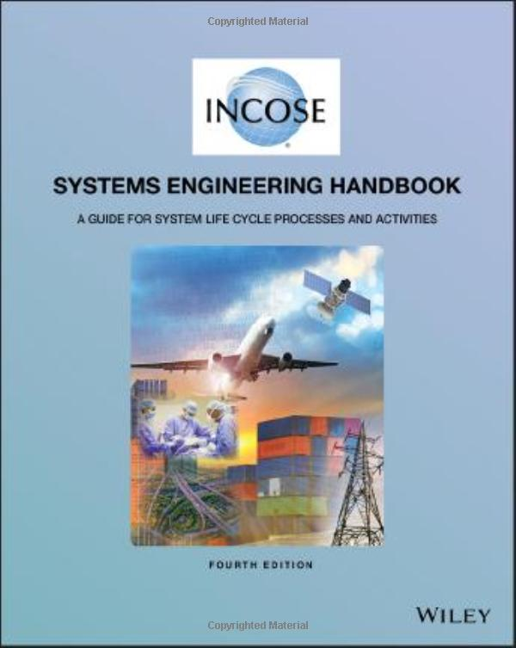
Value of Certification
INTERNATIONAL
STANDARD

Slide 21

Questions?

Slide 22
How to get Certified?

Slide 23
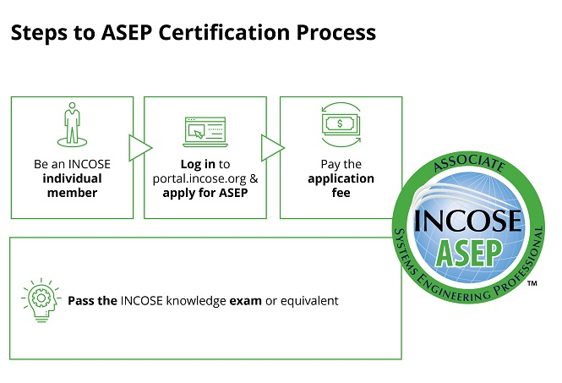
ASEP Certification Process

Slide 24
ASEP Certification Process
INCOSE Annual Memberships
Individual $160.00
Senior $90.00
Student $50.00

Slide 25
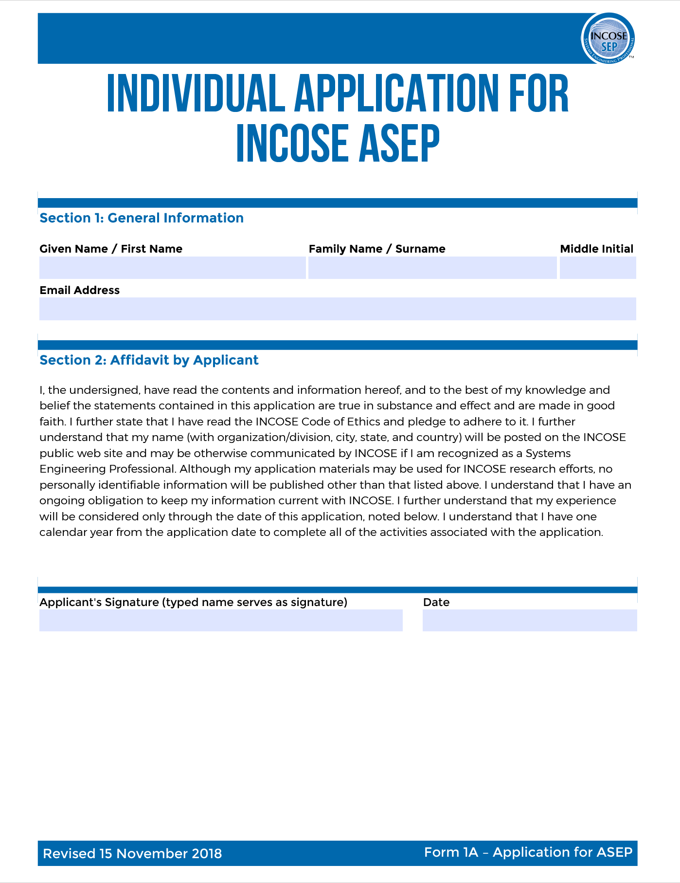
ASEP Certification Process

Slide 26
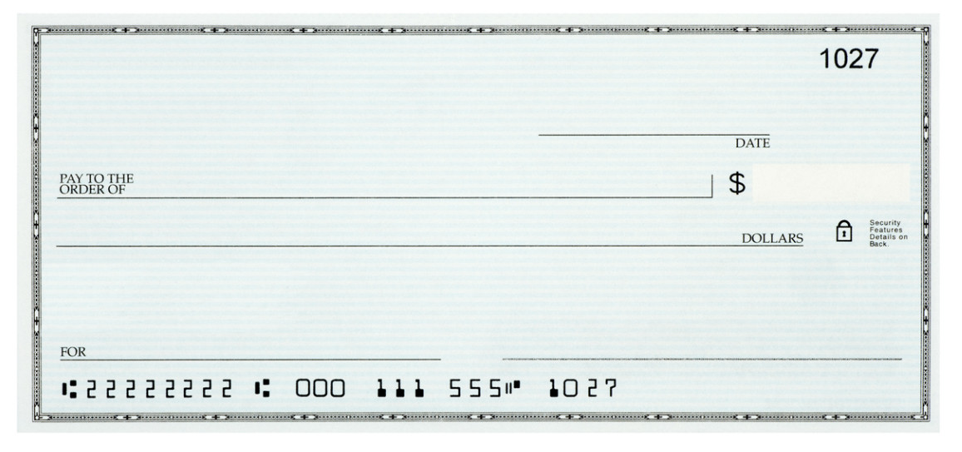
ASEP Certification Process
June 24, 2023
INCOSE
180.00
One Hundred Eighty and 00/100
Steve’s Bank
ASEP Application
Steven M. Biemer

Slide 27
ASEP Certification Process
SEP Knowledge Exam
Multiple choice test based on the INCOSE Systems Engineering Handbook.
Typically consists of 120 questions
  100 scored questions
  20 beta questions for future exams
Time: 1 minute per question (2 hrs.)
Closed book / closed note
Two modes (both proctored):
  Virtual (anytime)
  Paper (scheduled location)
Cost: $80.00

Slide 28
ASEP Certification Process
Academic Equivalency
Signed agreement between INCOSE and a university
If a student successfully passes an approved credit course based on the INCOSE SE Handbook, INCOSE will waive the knowledge exam.
Must have a signed agreement in place before taking the course.
Colorado State University
Cornell University
Drexel University
George Mason University
Missouri S&T University
Naval Postgraduate School
Southern Methodist University
University of Alabama in Huntsville
University of Detroit Mercy
University of Maryland Baltimore County
University of Maryland Global Campus
University of Michigan
University of New South Wales
Worcester Polytechnic Institute

Slide 29
Questions?

Slide 30
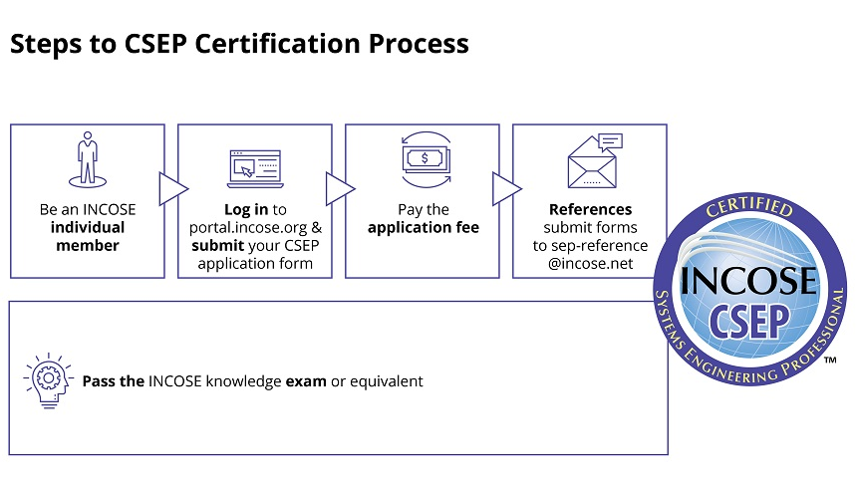
CSEP Certification Process

Slide 31
CSEP Certification Process
INCOSE Annual Memberships
Individual $160.00
Senior $90.00
Student $50.00

Slide 32
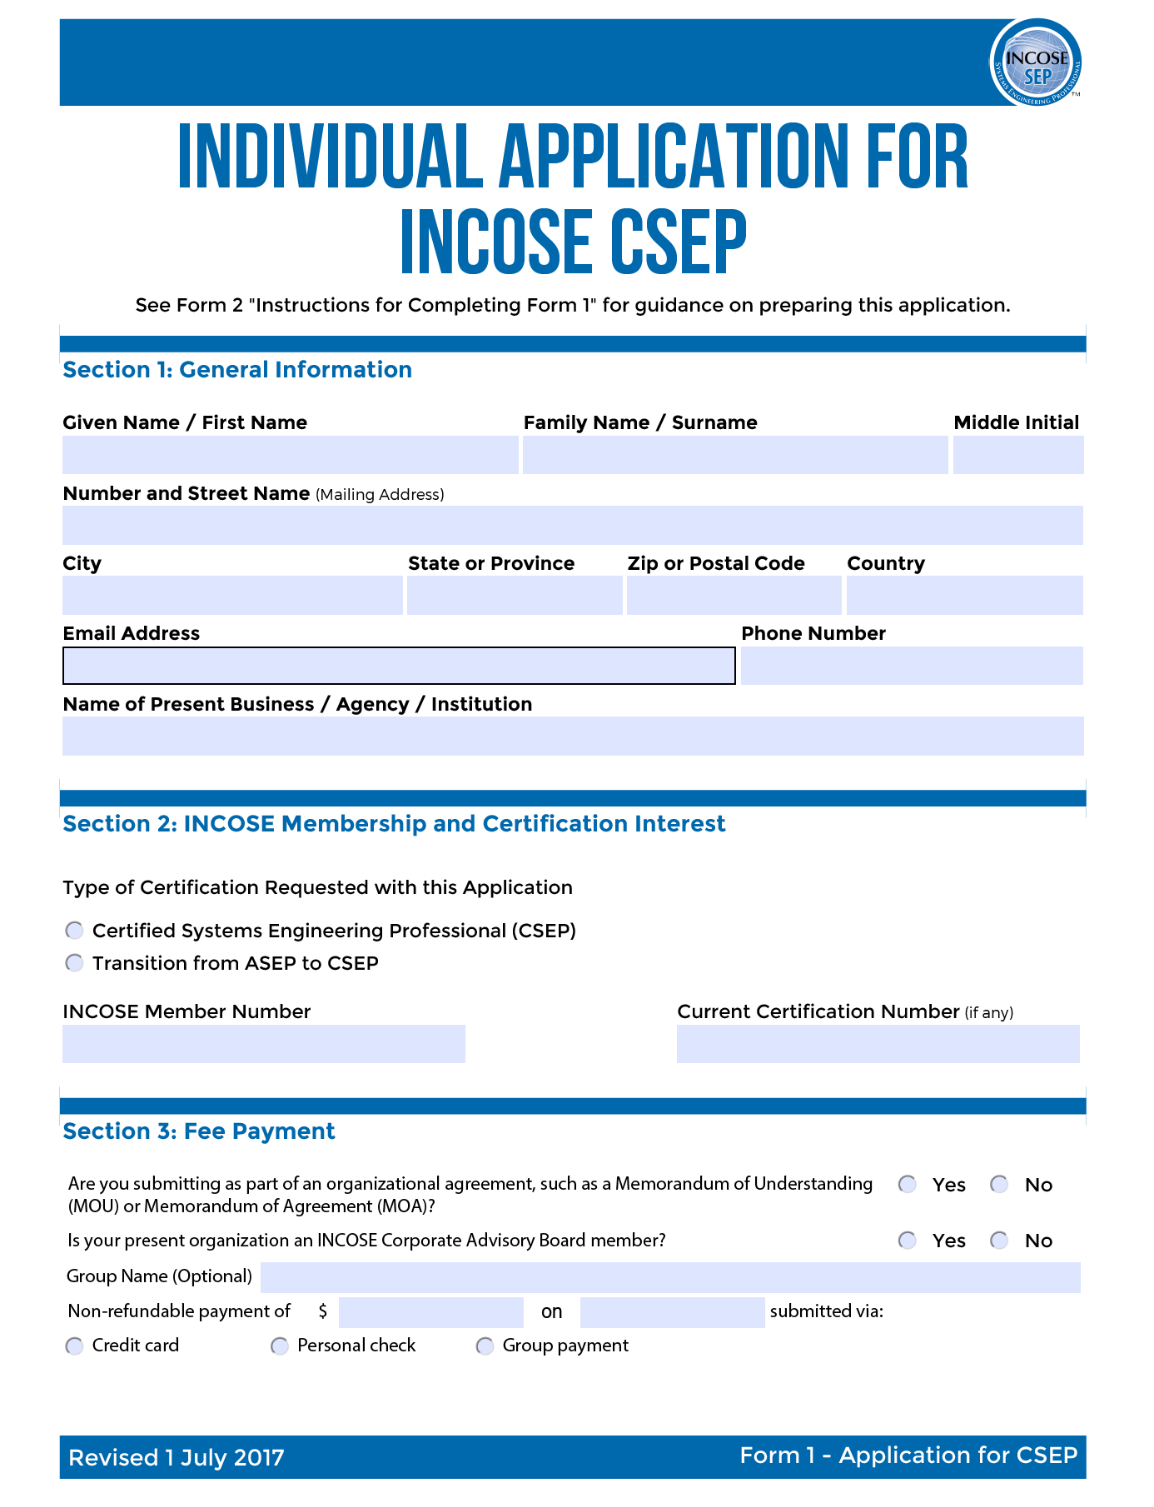
CSEP Certification Process

Slide 33
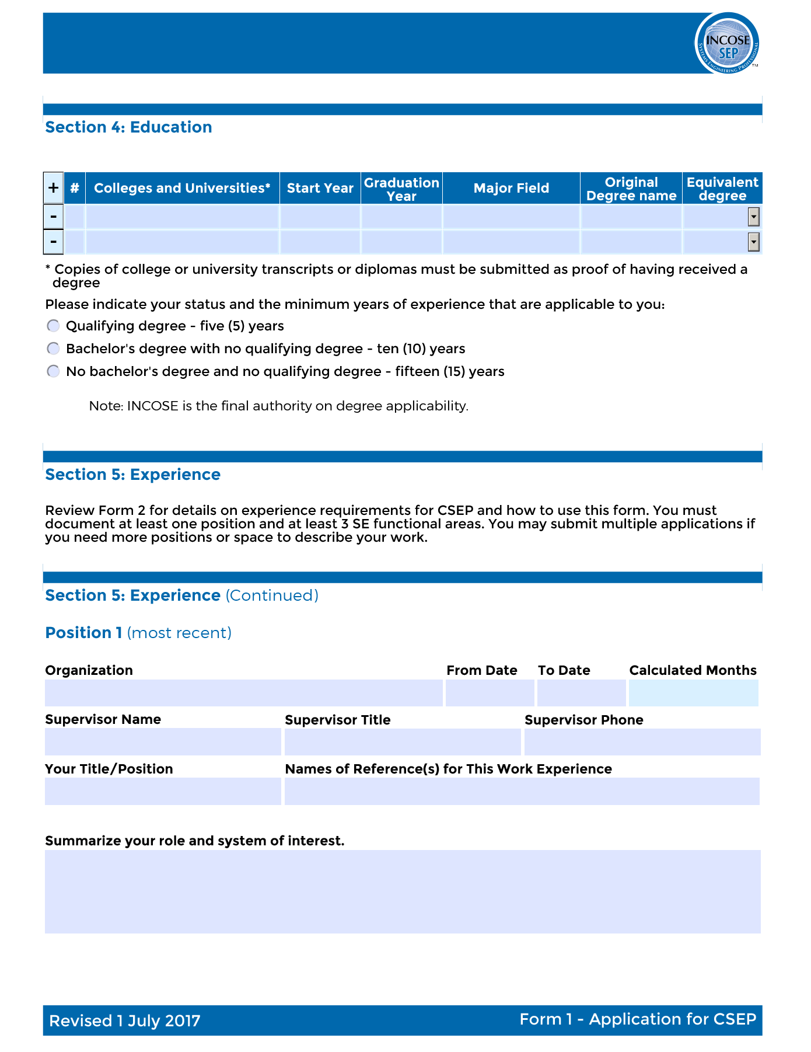
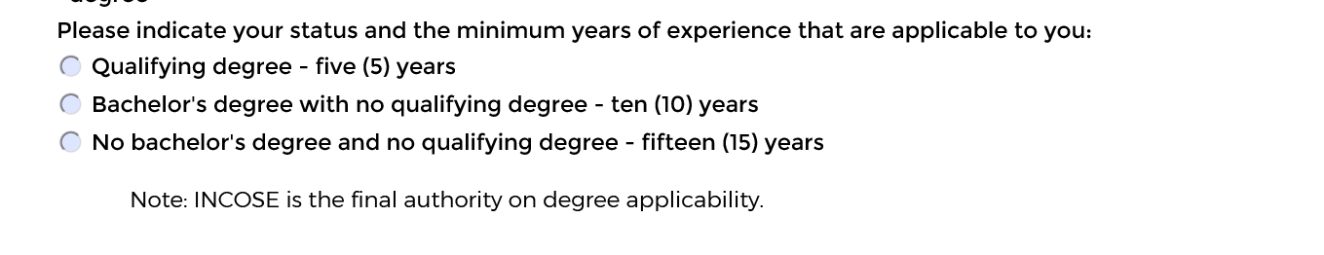
CSEP Certification Application
Must provide transcripts for all degrees.

Slide 34
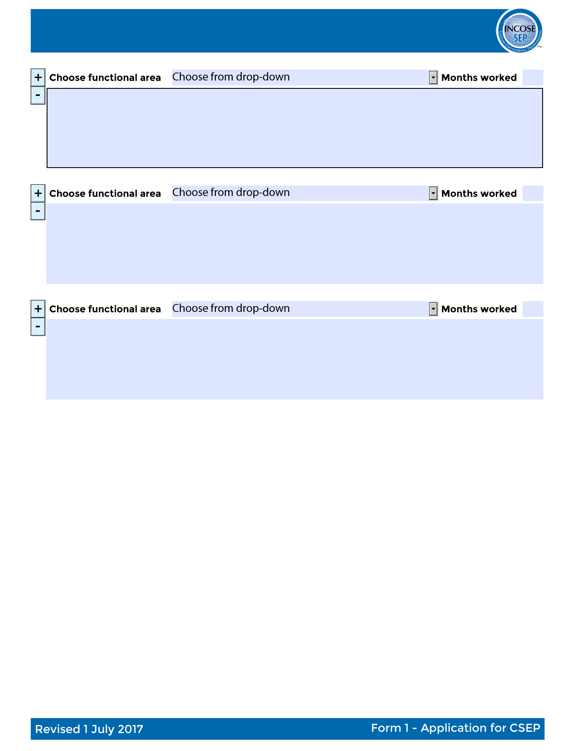
CSEP Certification Application
Functional Areas
Requirements Engineering
System and Decision Analysis
Architecture/Design Development
Systems Integration
Verification and Validation
System Operation and Maintenance
Technical Planning
Technical Monitoring and Control
Acquisition and Supply
Information and Configuration Management
Specialty Engineering
Organization Project Enabling Activities
Other
At least three functional areas

Slide 35
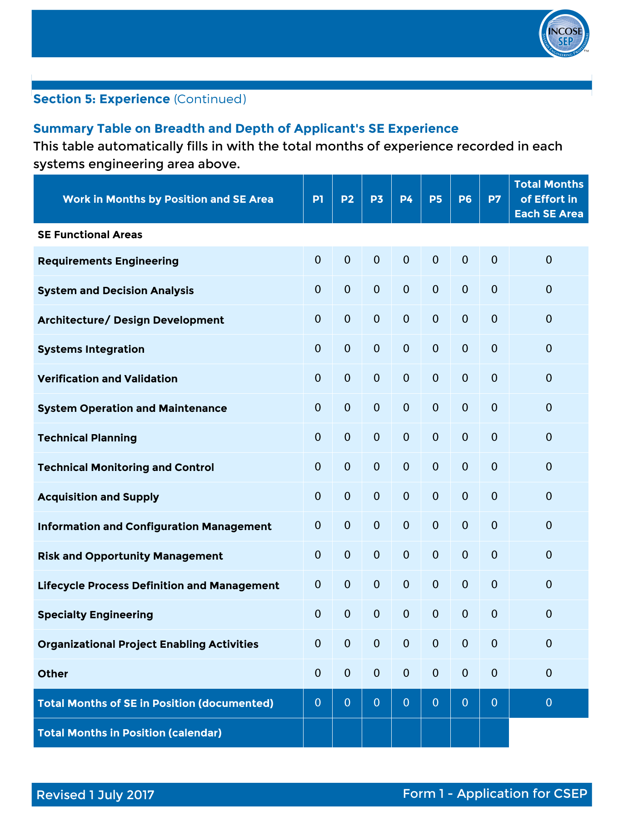
CSEP Certification Application
You must record the number of months of experience recorded in each systems engineering area above.
Total number of months must be at least 60.
At least three functional areas

Slide 36
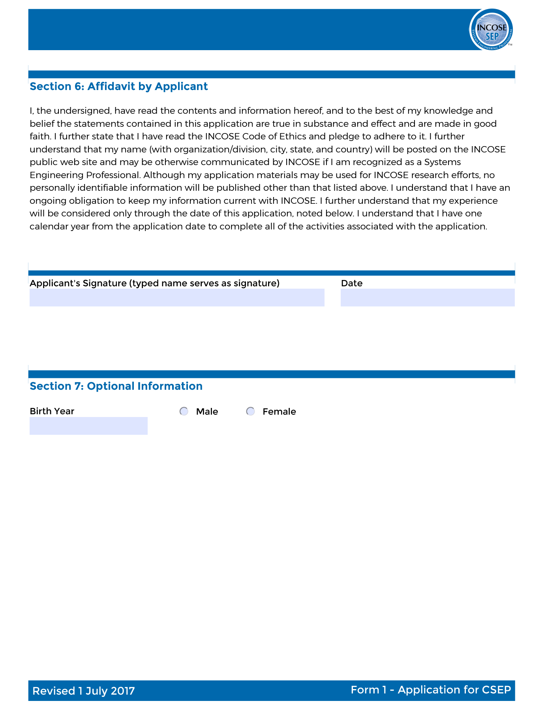
CSEP Certification Application
At least three functional areas

Slide 37
CSEP Certification Process
June 24, 2023
INCOSE
350.00
Three Hundred Fifty and 00/100
Steve’s Bank
CSEP Application
Steven M. Biemer

Slide 38
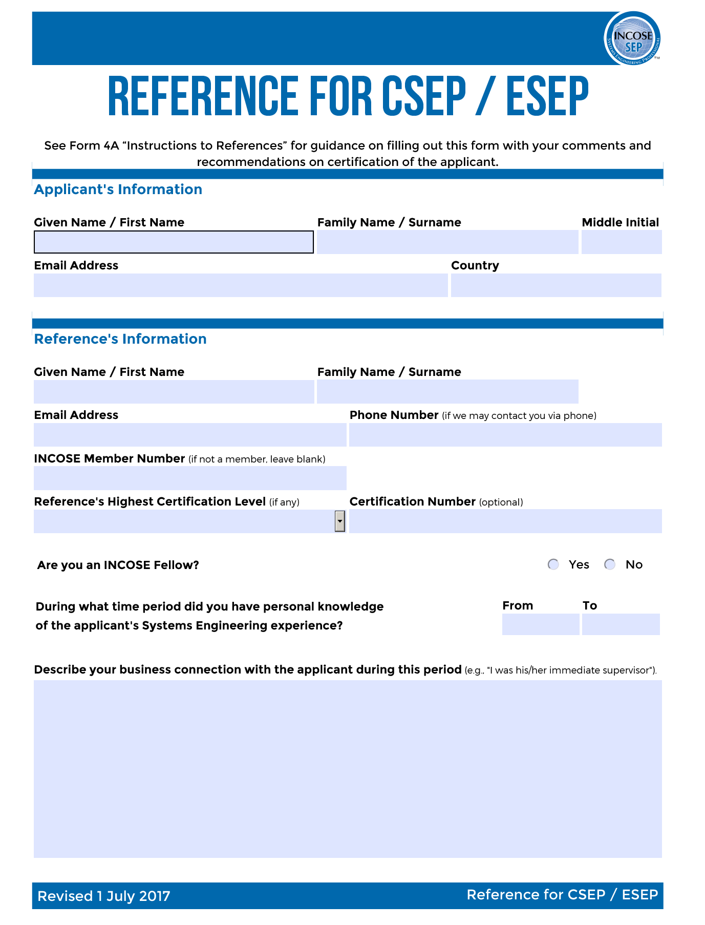
CSEP Certification Process

Slide 39
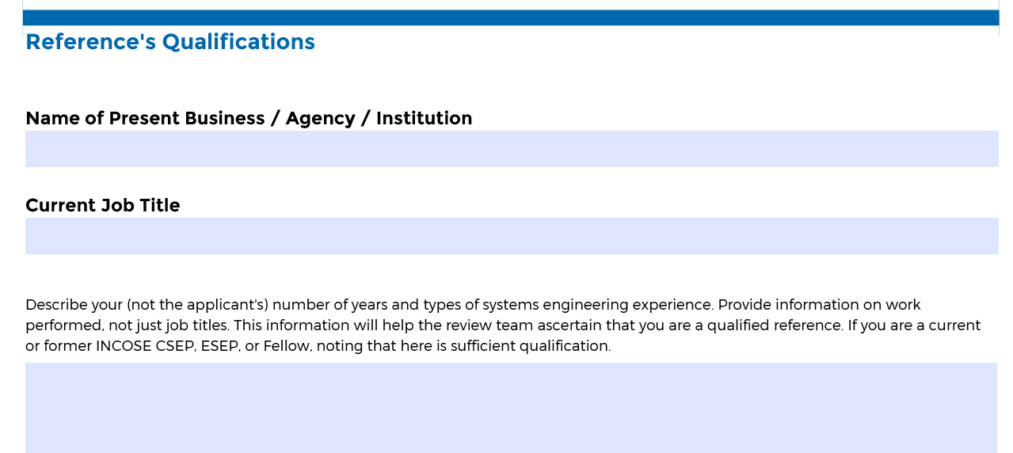
CSEP Certification Process

Slide 40
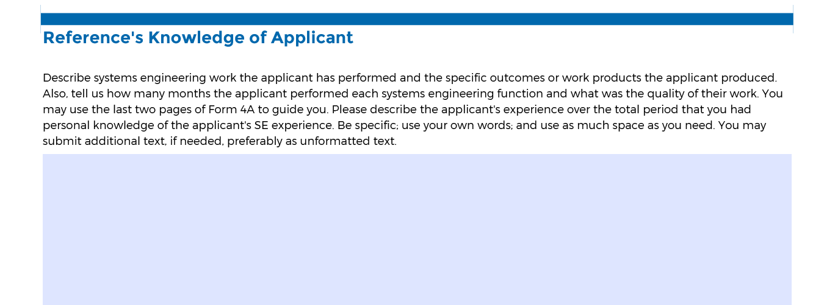
CSEP Certification Process

Slide 41
CSEP Certification Process
SEP Knowledge Exam
Multiple choice test based on the INCOSE Systems Engineering Handbook.
Typically consists of 120 questions
  100 scored questions
  20 beta questions for future exams
Time: 1 minute per question (2 hrs.)
Closed book / closed note
Two modes (both proctored):
  Virtual (anytime)
  Paper (scheduled location)
Cost: $80.00

Slide 42
CSEP Certification Process
Academic Equivalency
Signed agreement between INCOSE and a university
If a student successfully passes an approved credit course based on the INCOSE SE Handbook, INCOSE will waive the knowledge exam.
Must have a signed agreement in place before taking the course.
Colorado State University
Cornell University
Drexel University
George Mason University
Missouri S&T University
Naval Postgraduate School
Southern Methodist University
University of Alabama in Huntsville
University of Detroit Mercy
University of Maryland Baltimore County
University of Maryland Global Campus
University of Michigan
University of New South Wales
Worcester Polytechnic Institute

Slide 43

Questions?

Slide 44
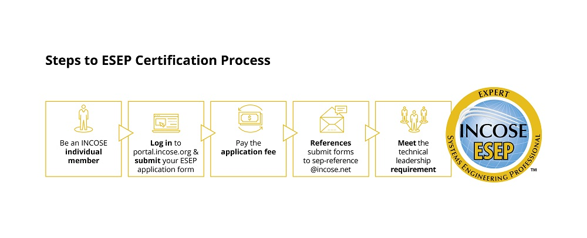
ESEP Certification Process

Slide 45
ESEP Certification Process
INCOSE Annual Memberships
Individual $160.00
Senior $90.00
Student $50.00

Slide 46
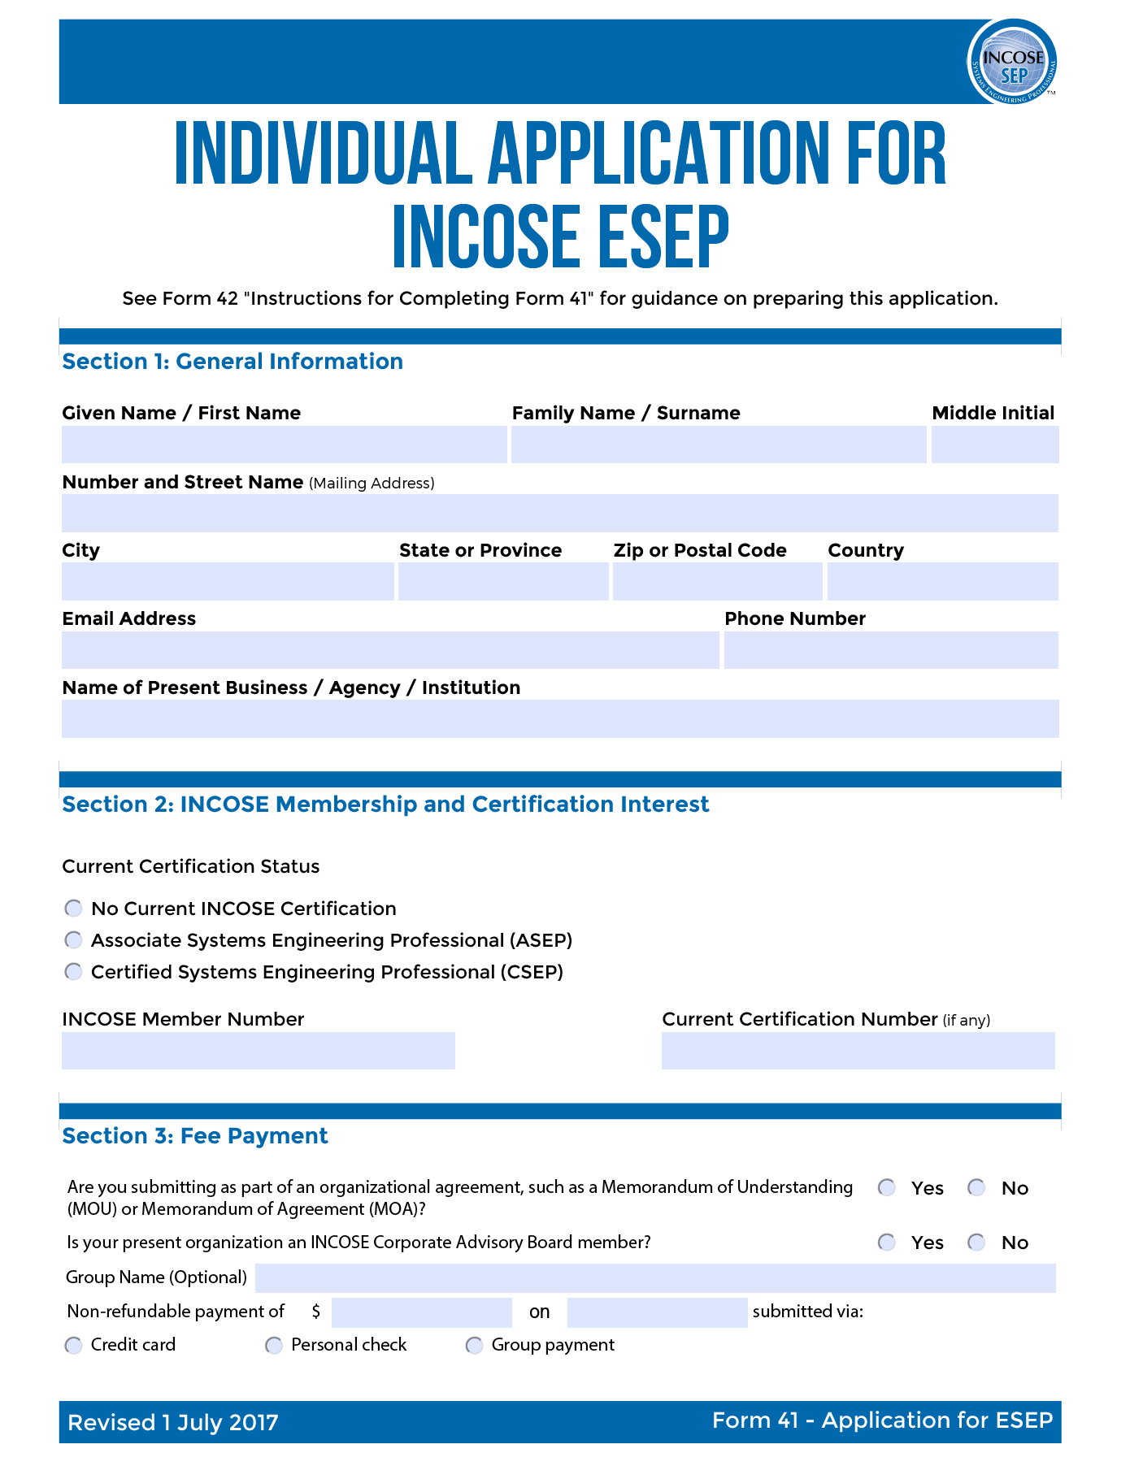
ESEP Certification Process

Slide 47
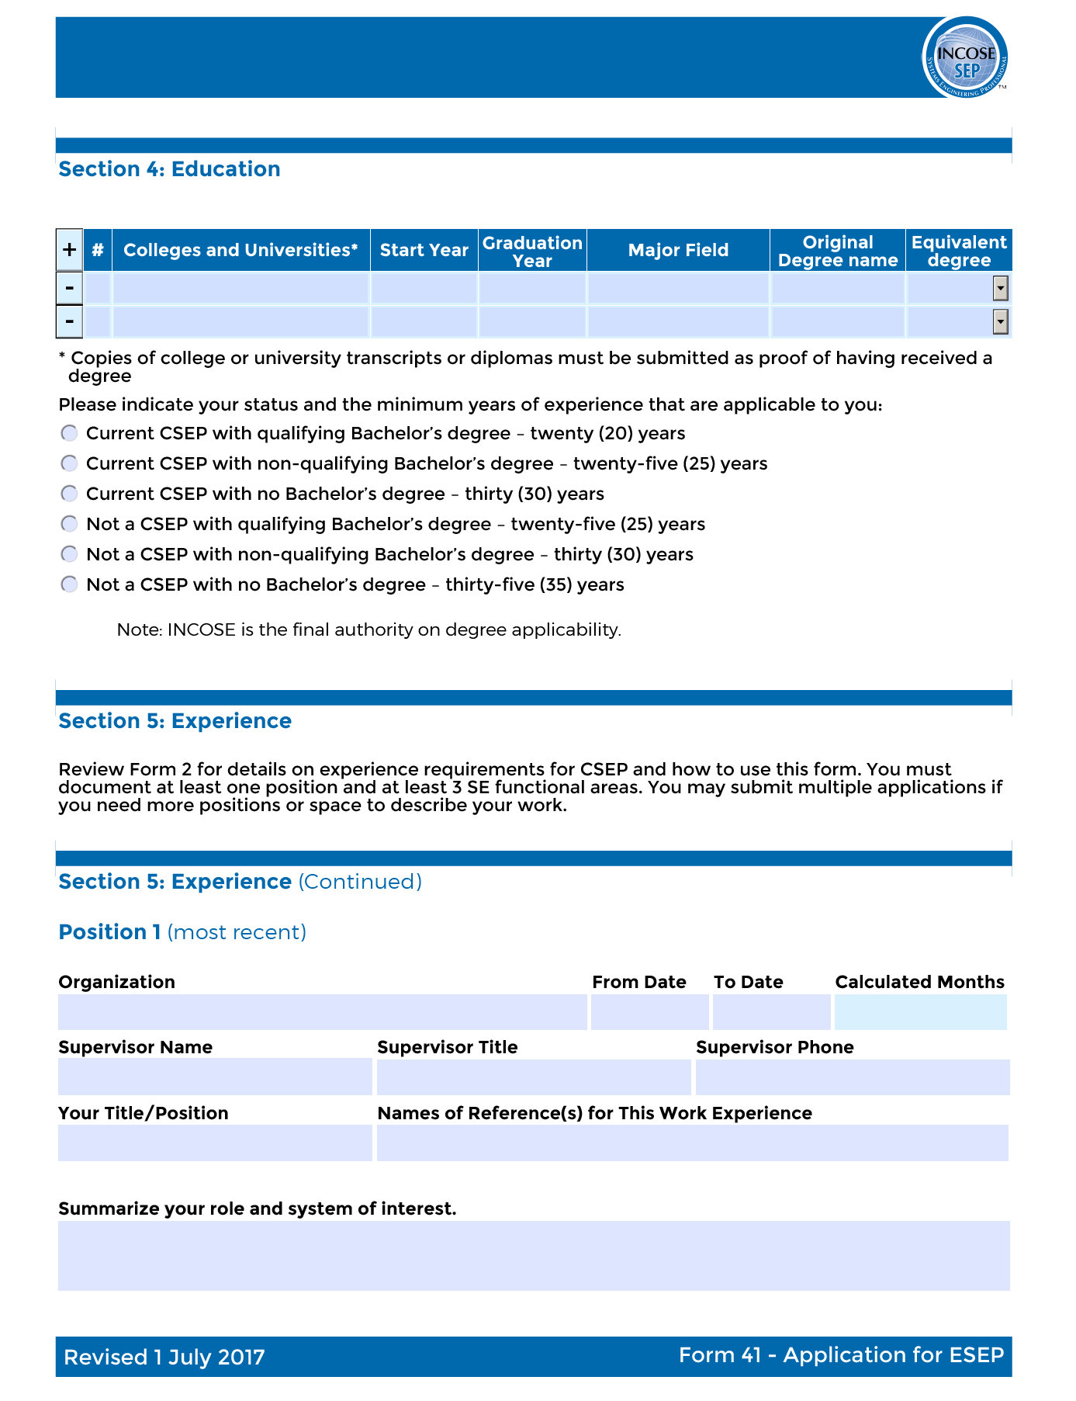
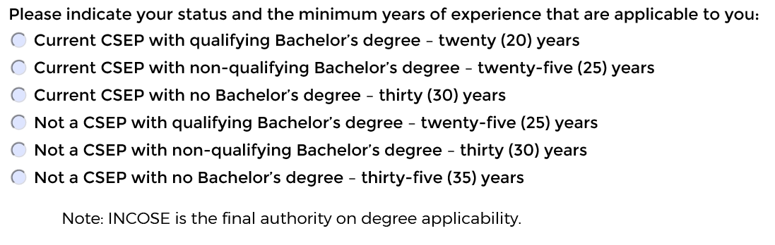
ESEP Certification Process
Must provide transcripts for all degrees.

Slide 48
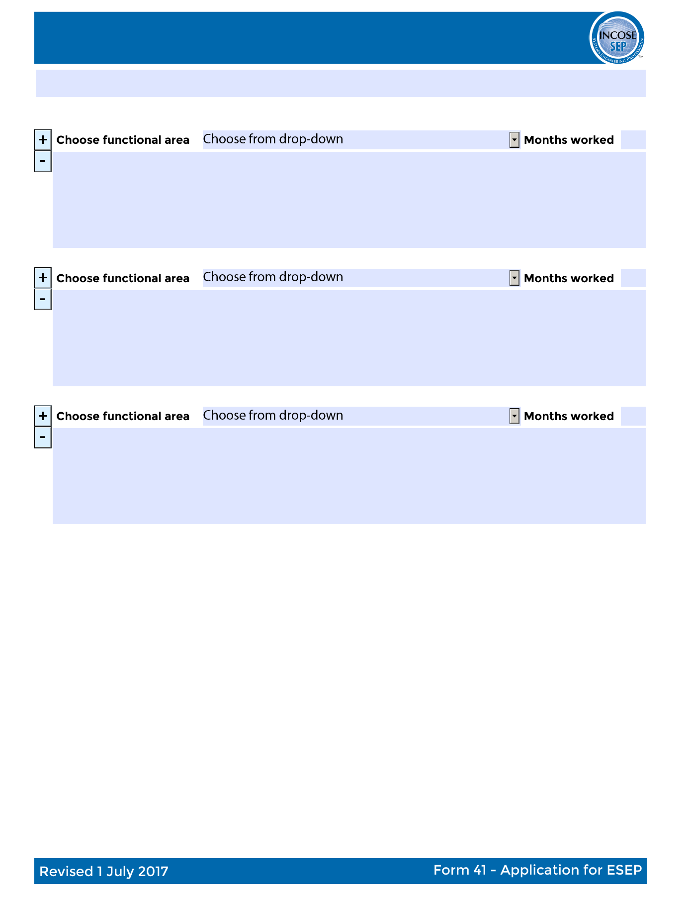
ESEP Certification Process
Functional Areas
Requirements Engineering
System and Decision Analysis
Architecture/Design Development
Systems Integration
Verification and Validation
System Operation and Maintenance
Technical Planning
Technical Monitoring and Control
Acquisition and Supply
Information and Configuration Management
Specialty Engineering
Organization Project Enabling Activities
Other

Slide 49
ESEP Certification Application
You must record the number of months of experience recorded in each systems engineering area above.
Total number of months must be at least 240.

Slide 50
ESEP Certification Application

Slide 51
ESEP Certification Process
June 24, 2023
INCOSE
630.00
Six Hundred Thirty and 00/100
Steve’s Bank
ESEP Application
Steven M. Biemer

Slide 52
ESEP Certification Process

Slide 53
ESEP Certification Process

Slide 54
ESEP Certification Process

Slide 55

ESEP Certification Process
Virtual or Phone Interview
One Hour
References may be asked to participate in 30 minute interviews (typically two interviews)

Slide 56

Questions?

Slide 57

How to Stay Certified?

Slide 58
Certification Renewal Process

Slide 59

Questions?

