Slide 1
INCOSE Chesapeake Chapter Webinar Understanding INCOSE SEP Certification Part 2 June 24, 2023
Host: Dr. Steve Biemer, CSEP

Slide 2
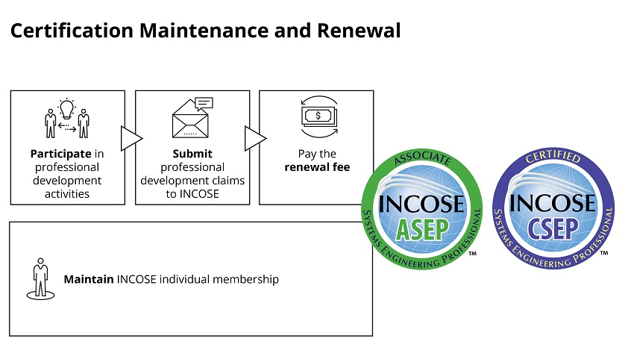
Certification Renewal Process

Slide 3
Certification Renewal Process
Professional Development Units
ASEP Renewal:
Period: Five years
Fee: $100 application fee
Membership required
120 PDUs required
CSEP Renewal:
Period: three years
Fee: $100 application fee
Membership required
120 PDUs required
ESEP:
No renewal required
Active membership required

Slide 4
Certification Renewal Process
Category 1: Technical Society Participation
Professional Development Units (PDUs)
ASEP: 120 PDUs
every 5 years
CSEP: 120 PDUs
every 3 years
INCOSE, CER-PROC-01, INCOSE SEP Certification Definition & Requirements, v1.0, April 2018

Slide 5
Certification Renewal Process
Category 2: SE Course Work & Publication
Professional Development Units (PDUs)
ASEP: 120 PDUs
every 5 years
CSEP: 120 PDUs
every 3 years
INCOSE, CER-PROC-01, INCOSE SEP Certification Definition & Requirements, v1.0, April 2018

Slide 6
Certification Renewal Process
Category 3: SE Job Function Participation
Professional Development Units (PDUs)
ASEP: 120 PDUs
every 5 years
CSEP: 120 PDUs
every 3 years
INCOSE, CER-PROC-01, INCOSE SEP Certification Definition & Requirements, v1.0, April 2018

Slide 7
Certification Renewal Process
Recordkeeping
The responsibility of the INCOSE member!
Must use the INCOSE log of continuing education EXCEL template, Form 13
INCOSE, CER-PROC-01, INCOSE SEP Certification Definition & Requirements, v1.0, April 2018

Slide 8
Certification Renewal Process
SUBMIT the PDU activities spreadsheet online at www.incose.org with the renewal fee.
INCOSE may ask you to provide verification of claimed activities.
INCOSE will audit your submission and approve or disapprove.
If you claim more than 120 PDUs, you may carry over up to 30 PDUs from one renewal period to another (only those above 120).
INCOSE, CER-PROC-01, INCOSE SEP Certification Definition & Requirements, v1.0, April 2018

Slide 9
Certification Renewal Process
If you miss your certification expiration date, you may submit a late renewal request; however, there is an additional fee and the PDU threshold increases as follows.
0-6 mo. 6-12 mo. >12 mo.
Fee $50 $100 $150
ASEP 12 PDUs 24 PDUs 24 PDUs/yr
CSEP 20 PDUs 40 PDUs 40 PDUs/yr
INCOSE, CER-PROC-01, INCOSE SEP Certification Definition & Requirements, v1.0, April 2018

Slide 10
Questions?

