Slide 1
INCOSE Chesapeake Chapter Webinar Understanding INCOSE SEP Certification Part 3 June 24, 2023
Host: Dr. Steve Biemer, CSEP

Slide 2
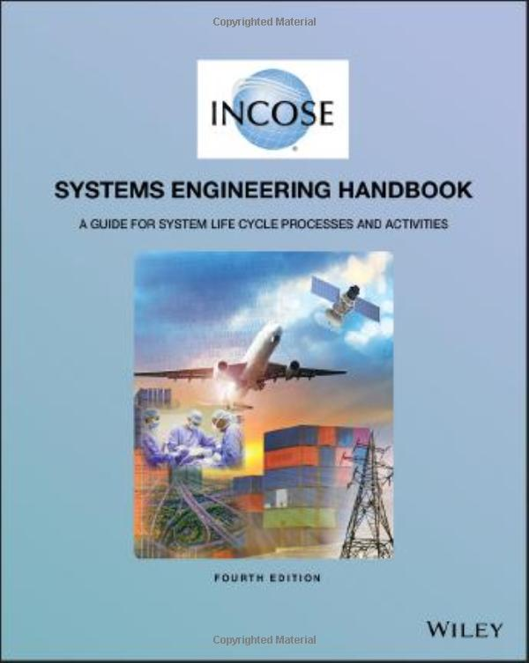
The SEP Knowledge Exam

Slide 3
INCOSE Systems Engineering Handbook
Systems Engineering Handbook Scope
Systems Engineering Overview
Generic Life Cycle Stages
Technical Processes
Technical Management Processes
Agreement Processes
Organizational Project-Enabling Processes
Tailoring Processes and Application of Systems Engineering
Cross-Cutting Systems Engineering
Specialty Engineering Activities

Slide 4
INCOSE Systems Engineering Handbook
Systems Engineering Handbook Scope
Systems Engineering Overview
Generic Life Cycle Stages
Technical Processes
Technical Management Processes
Agreement Processes
Organizational Project-Enabling Processes
Tailoring Processes and Application of Systems Engineering
Cross-Cutting Systems Engineering
Specialty Engineering Activities
ISO 15288 Standard

Slide 5
INCOSE Systems Engineering Handbook
Technical Processes
Technical Management Processes
Agreement Processes
Organizational Project- Enabling Processes
Business or Mission Analysis Process
Integration Process
Project Planning Process
Acquisition Process
Life Cycle Model Management Process
Stakeholder Needs & Requirements Definition Process
Verification Process
Project Assessment & Control Process
Supply Process
Infrastructure Management Process
System Requirements Definition Process
Transition Process
Decision Management Process
Portfolio Management Process
Tailoring Processes
Architecture Definition Process
Validation Process
Risk Management Process
Human Resource Management Process
Tailoring Process
Design Definition Process
Operation Process
Configuration Management Process
Quality Management Process
System Analysis Process
Maintenance Process
Information Management Process
Knowledge Management Process
Implementation Process
Disposal Process
Measurement Process
Quality Assurance Process
31 processes!

Slide 6
INCOSE Systems Engineering Handbook
Technical Processes
Technical Management Processes
Agreement Processes
Organizational Project- Enabling Processes
Source documents
Project constraints
Major stakeholder identification
Preliminary life-cycle concepts
Problem or opportunity statement
Business requirements
Alternative solution classes
Preliminary validation criteria
Validated requirements
Preliminary MOE needs
Preliminary MOE data
Business requirements traceability
Stakeholder needs
System requirements traceability
Inputs
Prepare for stakeholder needs and requirements definition
Define stakeholder needs
Develop the operational concept and other life cycle concepts
Transform stakeholder needs into stakeholder requirements
Analyze stakeholder requirements
Manage the stakeholder needs and requirements definition
Activities
Stakeholder needs and requirements definition strategy
Life-cycle concepts
System function identification
Stakeholder requirements
Validation criteria
MOE needs
MOE data
Stakeholder requirements traceability
Initial RVTM
Stakeholders needs and requirements definition record
Outputs
Business or Mission Analysis Process
Integration Process
Project Planning Process
Acquisition Process
Life Cycle Model Management Process
Stakeholder Needs & Requirements Definition Process
Verification Process
Project Assessment & Control Process
Supply Process
Infrastructure Management Process
Stakeholder Needs & Requirements Definition Process
System Requirements Definition Process
Transition Process
Decision Management Process
Portfolio Management Process
Architecture Definition Process
Validation Process
Risk Management Process
Human Resource Management Process
Design Definition Process
Operation Process
Configuration Management Process
Quality Management Process
System Analysis Process
Maintenance Process
Information Management Process
Knowledge Management Process
Implementation Process
Disposal Process
Measurement Process
Quality Assurance Process

Slide 7
INCOSE Systems Engineering Handbook
Systems Engineering Handbook Scope
Systems Engineering Overview
Generic Life Cycle Stages
Technical Processes
Technical Management Processes
Agreement Processes
Organizational Project-Enabling Processes
Tailoring Processes and Application of Systems Engineering
Cross-Cutting Systems Engineering
Specialty Engineering Activities
Modeling & Simulation
MBSE
Functions-Based SE
Object Oriented SE
Prototyping
Interface Management
Integrated Product and Process Development
Lean SE
Agile SE

Slide 8
INCOSE Systems Engineering Handbook
Affordability
Electromagnetic Compatibility
Environmental Engineering
Interoperability Analysis
Logistics Engineering
Manufacturing & Producibility
Mass Properties Engineering
Reliability, Availability, & Maintainability
Resilience Engineering
System Safety Engineering
System Security Engineering
Training
Usability / Human Systems Integr.
Value Engineering
Systems Engineering Handbook Scope
Systems Engineering Overview
Generic Life Cycle Stages
Technical Processes
Technical Management Processes
Agreement Processes
Organizational Project-Enabling Processes
Tailoring Processes and Application of Systems Engineering
Cross-Cutting Systems Engineering
Specialty Engineering Activities

Slide 9
Recommendation
Academic Courses (e.g., UMBC & UMGC)
Training Courses (e.g., SE Scholar, https://se-scholar.com/)
Study Groups

Slide 10
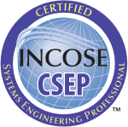
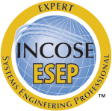
Questions?

