Slide 1
INCOSE Chesapeake Chapter Webinar Understanding INCOSE SEP Certification Part 4 June 24, 2023
Host: Dr. Steve Biemer, CSEP

Slide 2
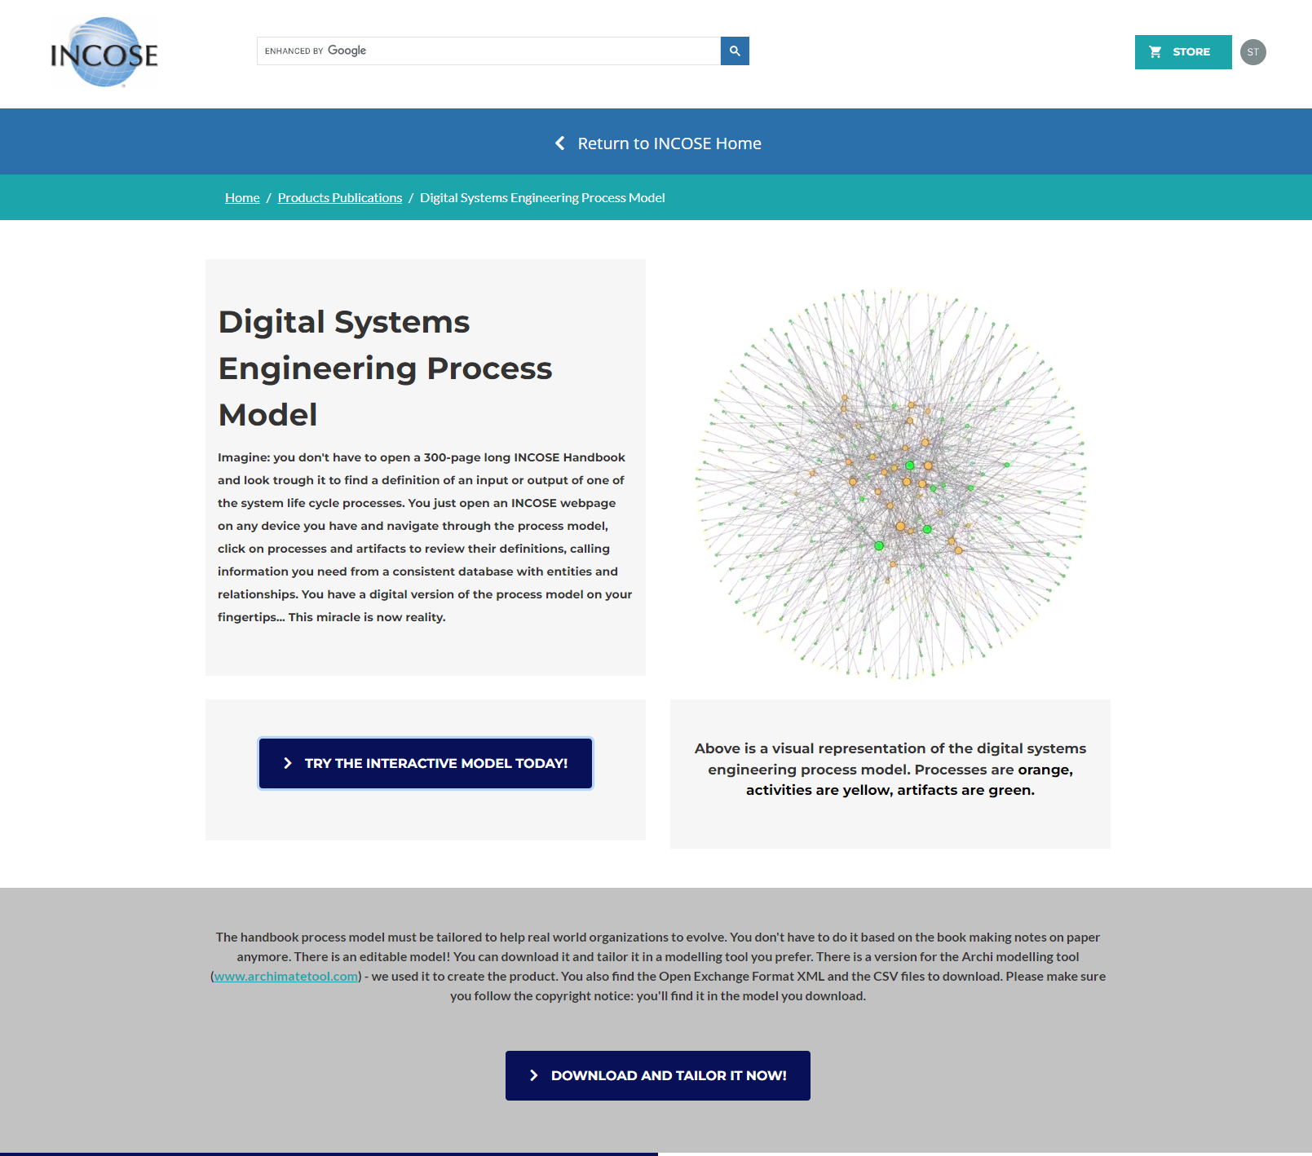
INCOSE Systems Engineering Process Model
https://www.incose.org/products-and-publications/digital-systems-engineering-process-model

Slide 3
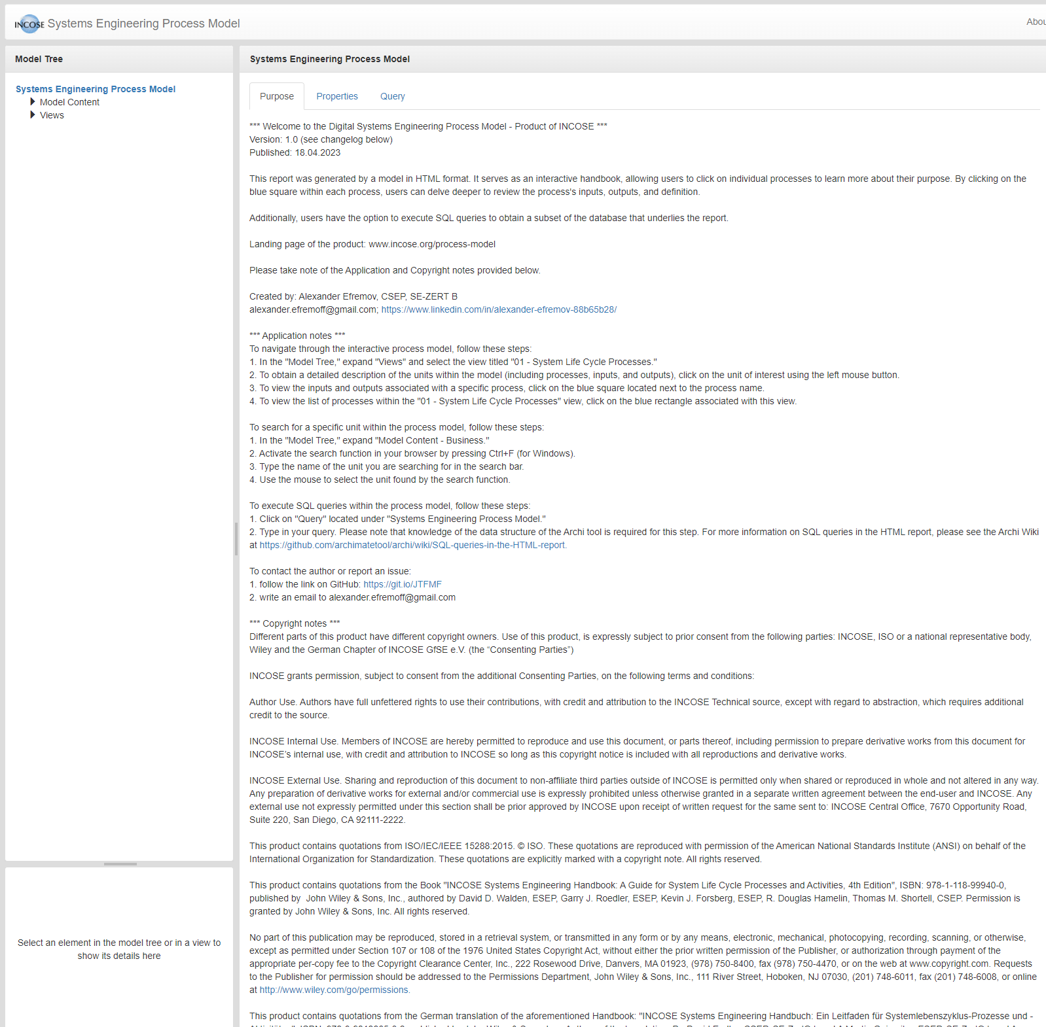

Slide 4
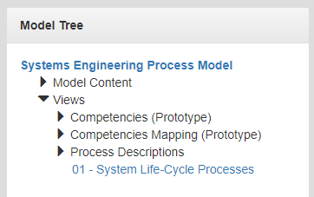

Slide 5
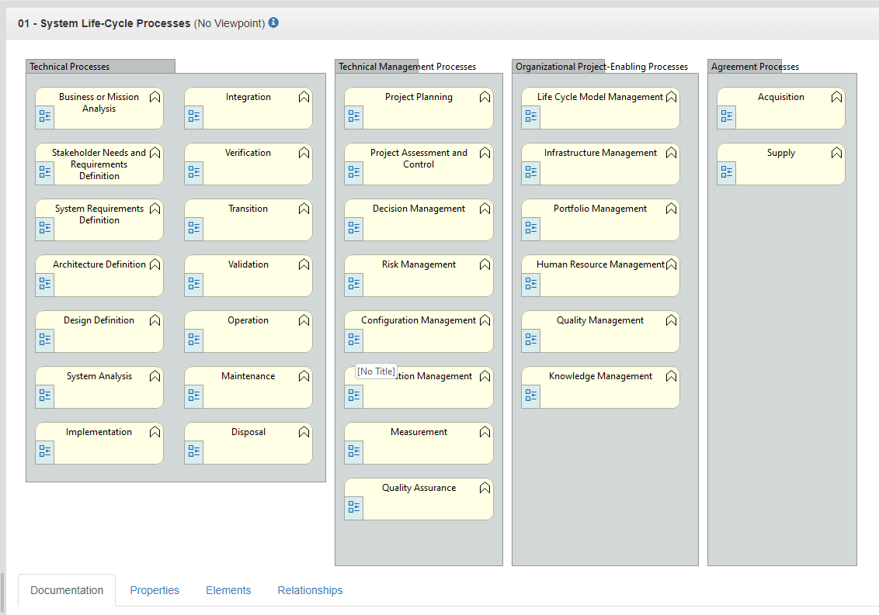

Slide 6
Questions?

